Slide 1
Reaching the SDGs and generating shared value for people and nature with sustainable palm oil
Eliza Anyangwe

Slide 2
The Role of Palm Oil Industry to Expedite SDGs Achievement
Lim Sian Choo
Bumitama Agri Ltd (Indonesian Grower)

Slide 3
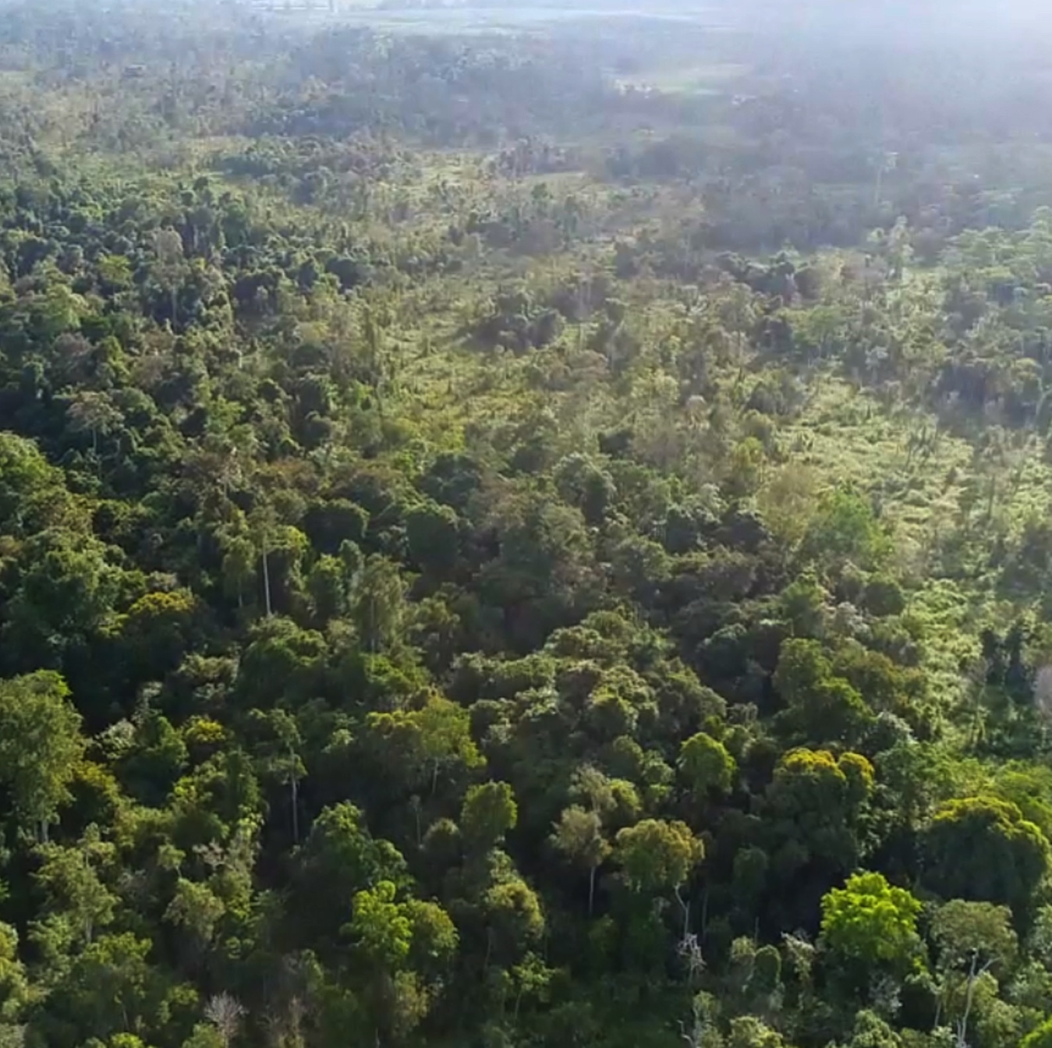
CEO’s aspiration
“It has always been my personal view that Bumitama should be a good citizen in the region and country where we operate, and contribute to the greater global goal of looking after our planet. But, most importantly, we must also provide people with good livelihoods and respect the rights and aspirations of both our own employees and our local communities.”
(Quote from EC and CEO extracted from Bumitama Sustainability Report 2016)
Bumitama adopted a NDPE policy in August 2015;
Shared value is a creation of common vision that can be embraced by multiple stakeholders.

Slide 4
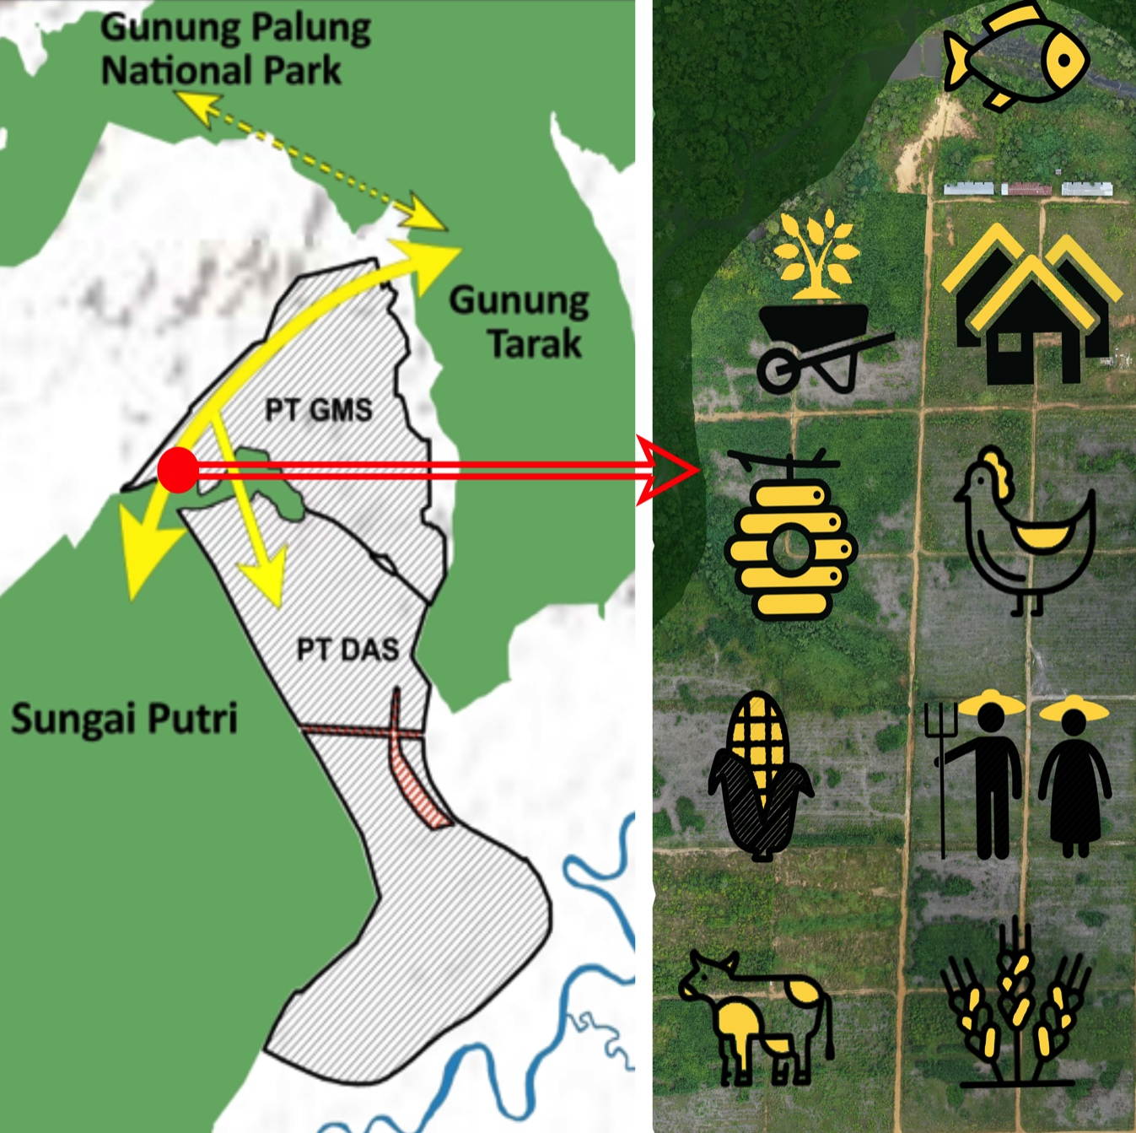
Life on Land - Bumitama biodiversity and community project
Trial concept of collaborative multi-stakeholder landscape approach by building a corridor linking protected forests, focusing on protection, production and inclusion;
Participatory assessment for 8 villages the start of Village Level Land Use Plans (VLLP) which also provide for government spatial planning and budgets (PKP);
Project alignment with the Provincial and Regional government Green Growth Programme, Kawasan Ekosistem Esensial, District’s Mid-term Development Plan (or RPJMD);
Many challenges, many stakeholders, but if successful will yield huge benefits for all.

Slide 5
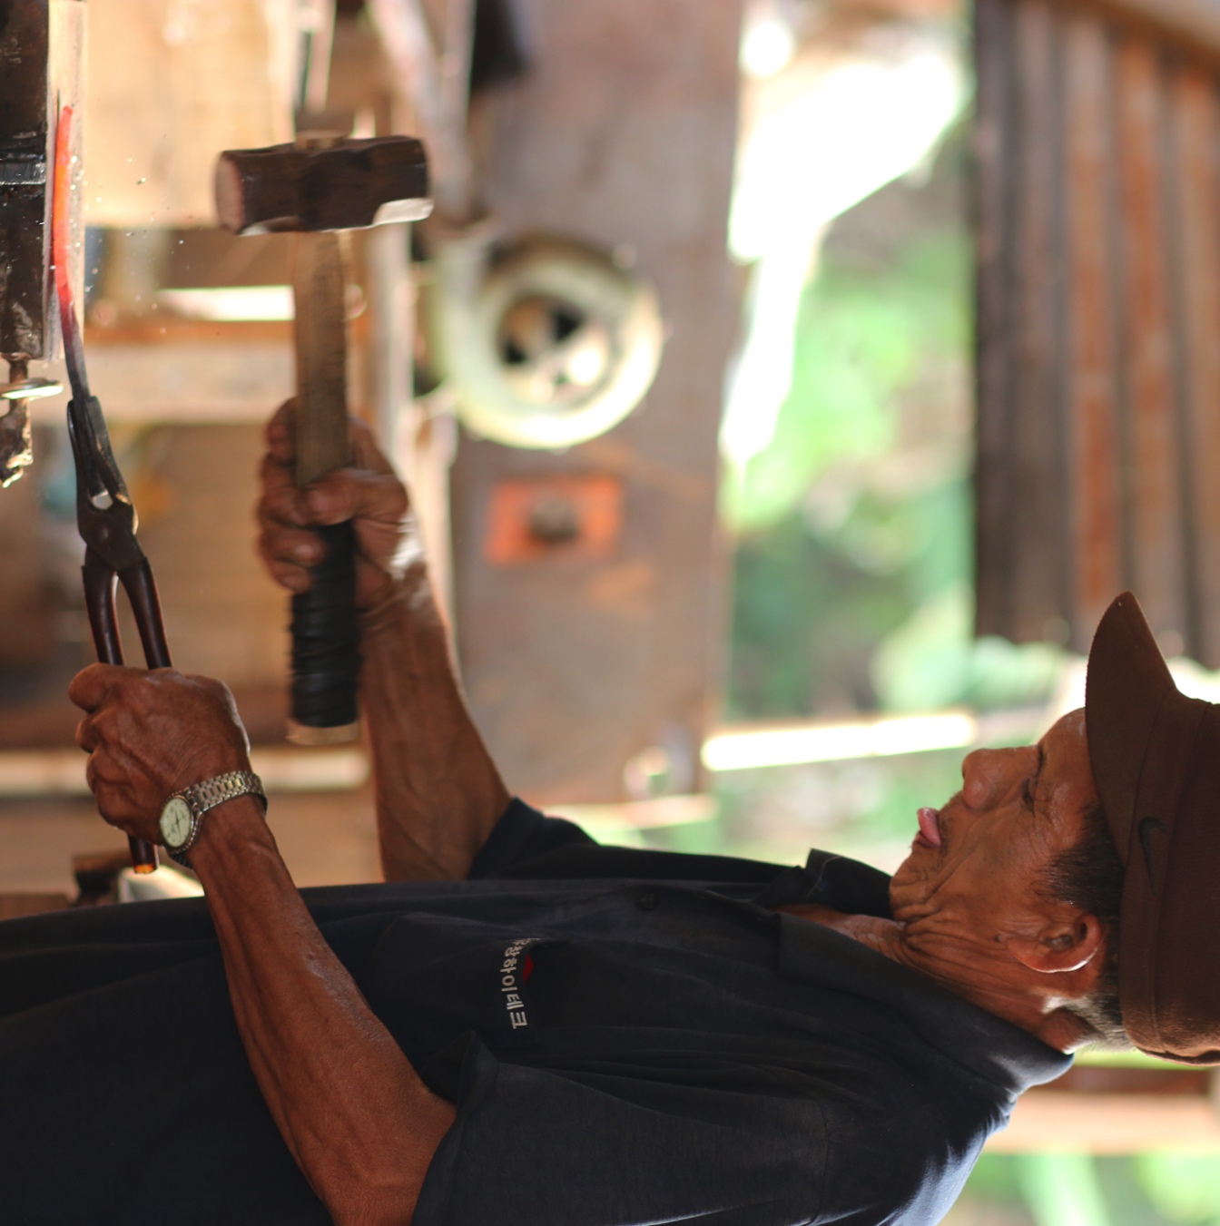
Inclusion of the communities
Bumitama capacity building and sustainable economic development - 64 community groups given livelihood alternative;
Teluk Pulai near to Tanjung Putting Park
  Neglected village of old persons;
  Employment from Bumitama provided financial means for other businesses e.g. harvesting 60 swiftlet nests generating additional income of IDR 70 mil to IDR 80 mil per season;
  Give back to environment by reforesting.
With plasma farmers and other independent farmers
  Bumitama blacksmith buyback projects; launched in 2013, now 9 groups and expanding product range from just dodos.

Slide 6
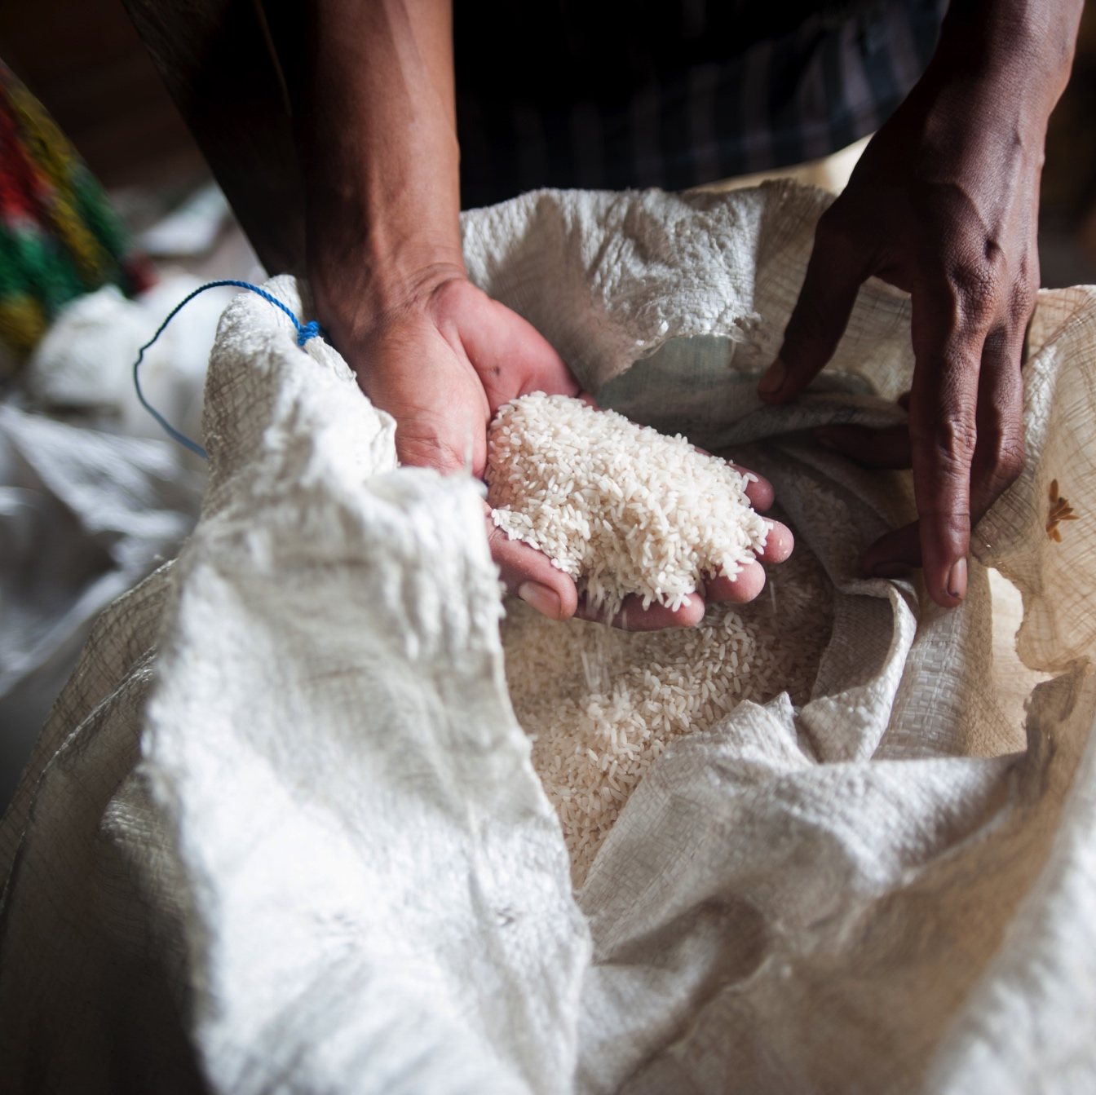
Inclusion of the communities
Bumitama internal food-source project
  Teach and provide seeds to workers to plant vegetable & fish on their front yard;
  Distribution of rice to our workers.
External food source project, increase yields or access to land example rice planting in Teluk Pulai (beside for own consumption generated IDR3.5 billion for 50 families) and Kandawangan;
Show, teach and harvest training centres using integrated farming in GMS and KMB;
Empowering women in Central Kalimantan with mushroom farming.

Slide 7
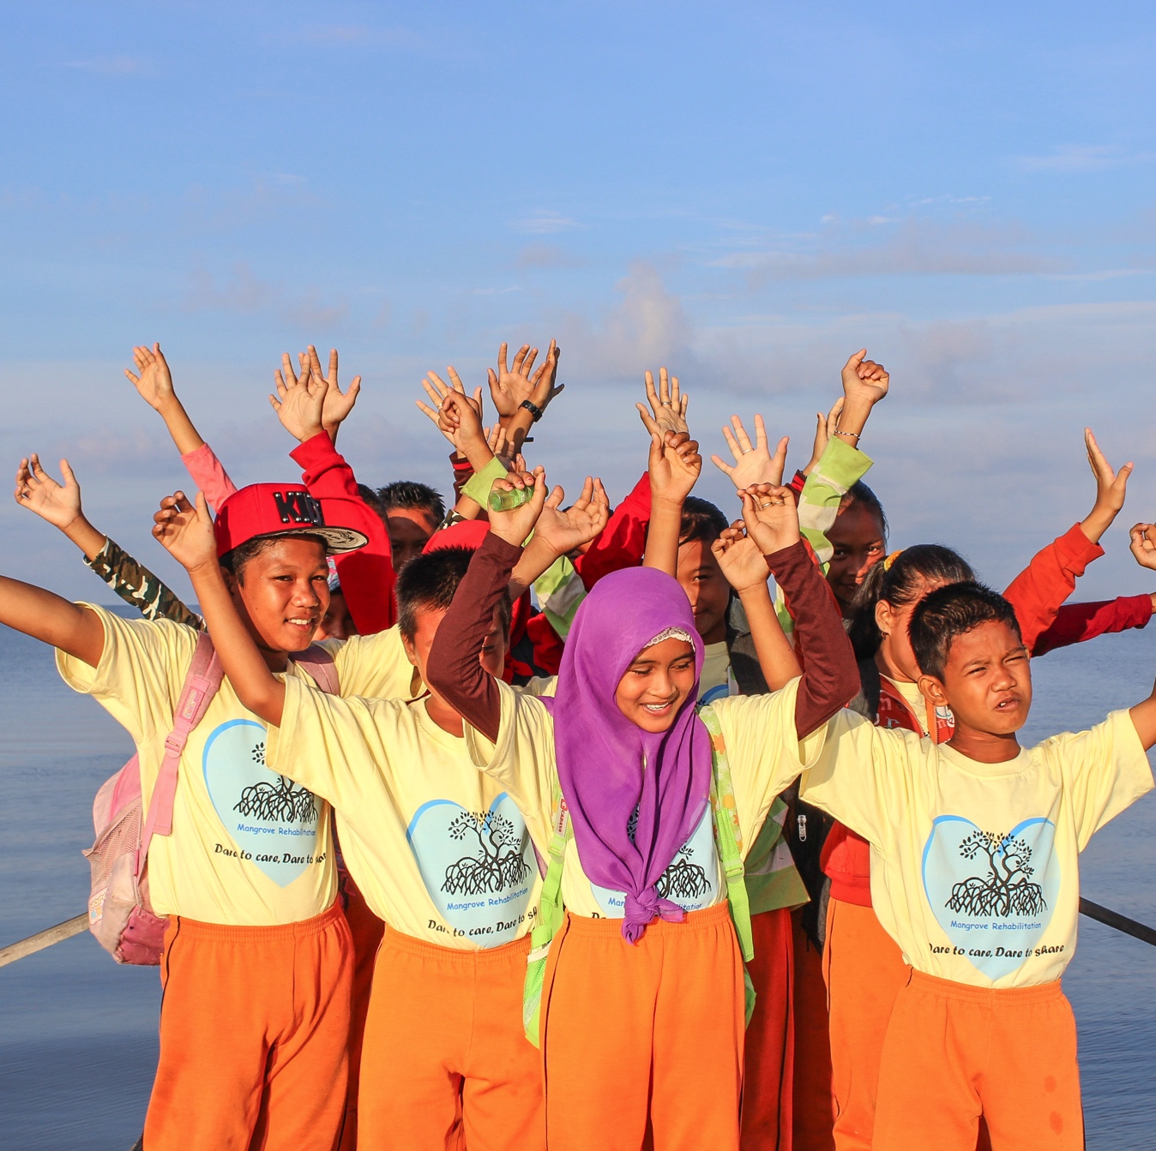
Children as the future
Indonesian population is a young one; 27% below 15 years;
About 13% of Indonesian children (11 million) still live in households with the income level below the national poverty line (about $ 0.9/day);
Bumitama and other stakeholders must engage actively with the government in improving on the SDGs, providing long-term stability and economic independence for multiple generations;
Children play a special role for Bumitama
  Children = investment into our future & Indonesia’s future; future potential staff, colleagues, shareholders and customers.

Slide 8
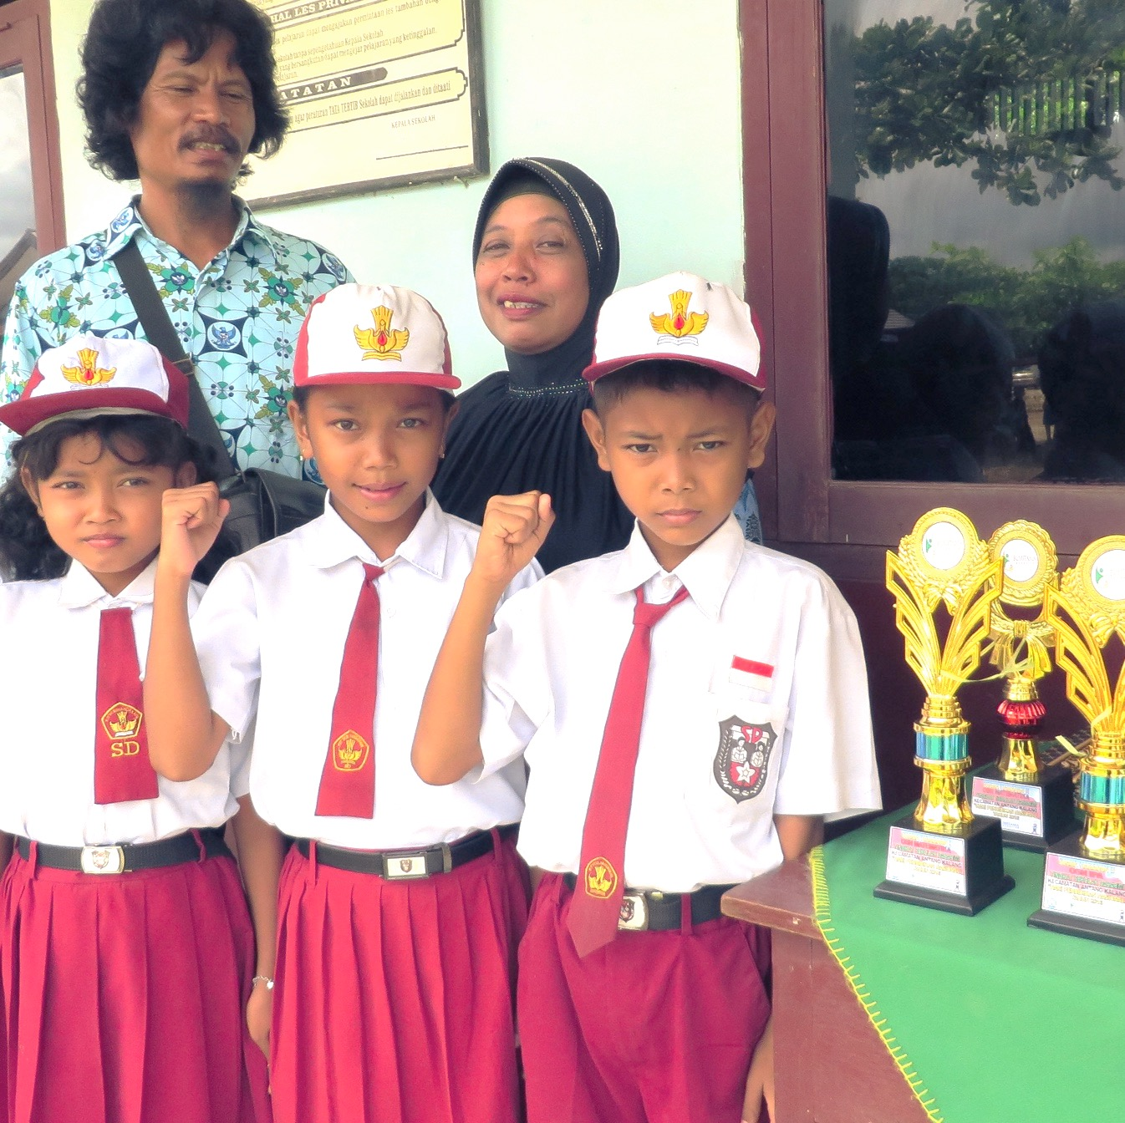
Education as the agent of change
Quality education is made accessible to 4,774 employees children through 36 internal schools (4,800 children) and 10 external partnership schools;
All Bumitama’s schools are ranked within top 75% of provincial schools;
Adiwiyata Green Schools - 4 schools certified at District level and1 school at Provincial level;
Assessing children rights and protection in collaboration with Indonesia’s Ministry of Women’s Empowerment and Children’s Protection, the RSPO and a global organisation.

Slide 9
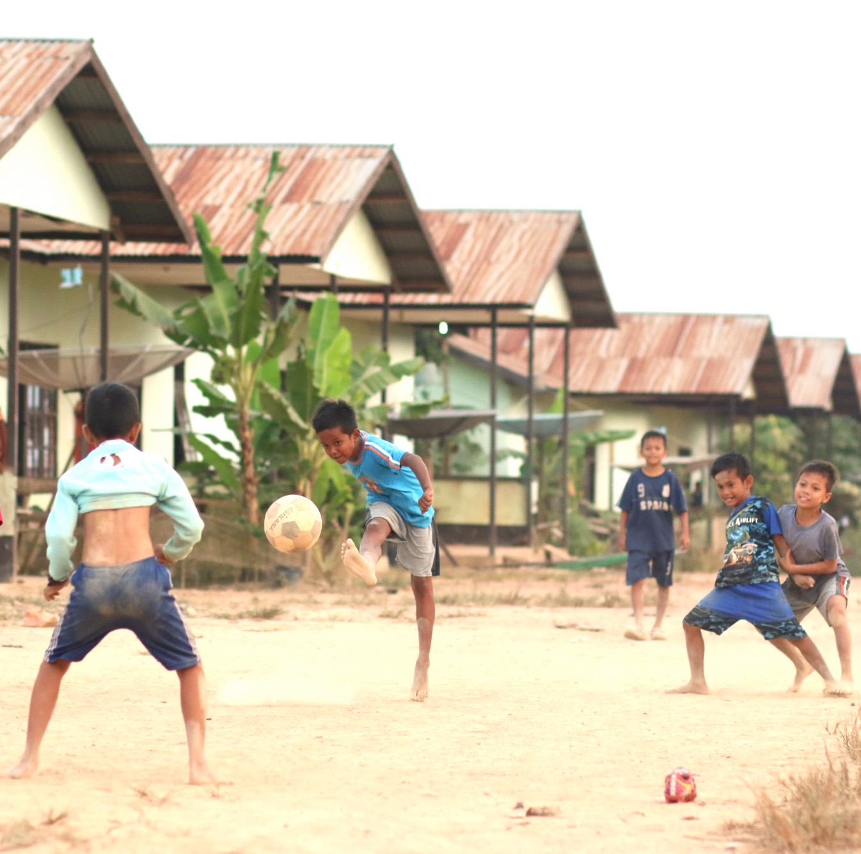
Reduction of poverty
Between 1999 – 2017 poverty rate in Indonesia decreased from 23.4 % to 10.1%;
Rural areas have double poverty rate in comparison with urban areas;
Agriculture (oil palm) has been the driving force of the decrease, generating wealth and employment, creating 17 million jobs, including 2 million smallholder farmers;
Bumitama employs over 26,000 workers with minimum starting wages 10-20% higher than the regional minimum wage;

Slide 10
Reduction of poverty - higher regional GDP growth
Between 2000 – 2013 the GDP of the regions with palm oil production grew almost twice as fast as the one of the non-sawit regions, when in this period it multiplied 7 fold;
Palm oil development creates opportunities for rural areas, especially for poor households;
It boosts employment and generates new incomes, with a potential spill over effect to other sectors by increasing demand for products, fostering infrastructure development and access to public goods.
IDR Trillion
GDP Oil Palm regions
GDP Non-oil Palm regions
Source of data: Palm Oil Agribusiness Strategic Policy Institute 2014

Slide 11
Reduction of poverty - higher income per capita for 2015
Income of palm oil smallholders in the 7 provinces is on average higher by 61% higher than the minimum wage and 163% higher than of the padi farmers.
PROVINCE | OIL PALM SMALLHOLDER | PADI FARMERS | MINIMUM WAGE
North Sumatra | 3,508,325 | 1,040,000 | 1,625,000
West Sumatra | 1,992,252 | 1,204,000 | 1,615,000
Sumatra | 1,688,761 | 980,346 | 1,974,346
Jambi | 3,210,000 | 1,001,400 | 1,710,000
Lampung | 3,853,000 | 1,285,720 | 1,581,000
Riau | 2,896,667 | 998,100 | 1,878,000
South Kalimantan | 2,636,401 | 1,017,000 | 1,870,000
AVERAGE | 2,826,487 (€ 173) | 1,075,224 (€ 66) | 1,750,478 (€ 107)
Source of data = 2016 preliminary studies by 9 universities and 1 research center, funded by IECF, compiled by Dr. Diana Chalil of University of North-Sumatera

Slide 13
Reaching the SDGs and generating shared value for people and nature with sustainable palm oil
Ludovic Mirao II
WWF Regional Office for Africa, Yaounde Hub

Slide 14
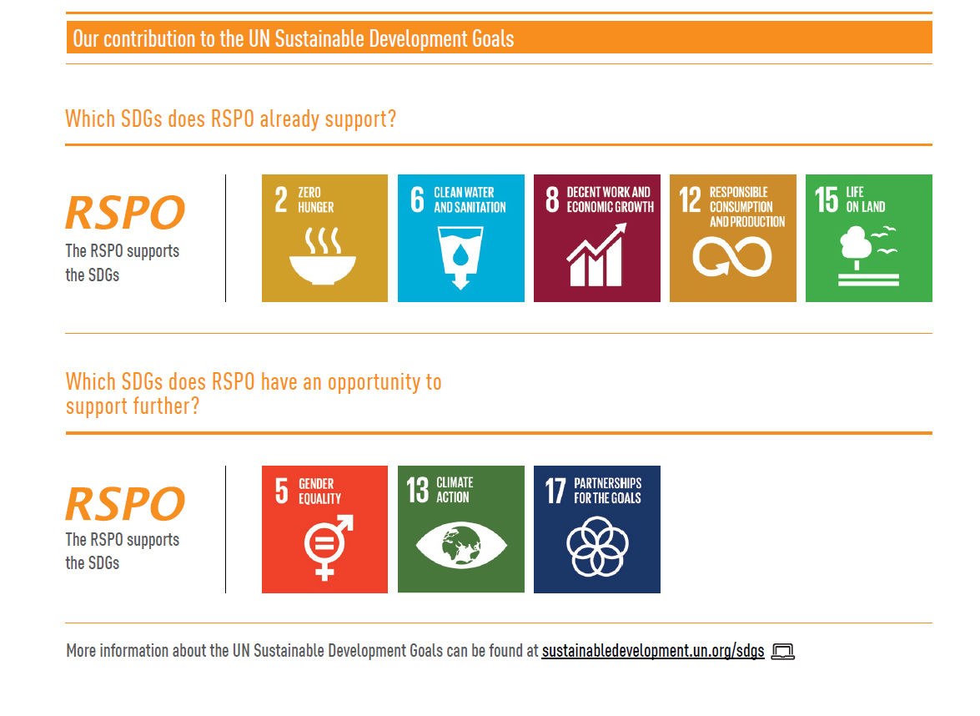
RSPO’s contribution to the SDGs

Slide 16
UNILEVER SUSTAINABLE LIVING PLAN AND sdgs
Jan-Kees Vis
Global Director Sustainable Sourcing Development

Slide 17
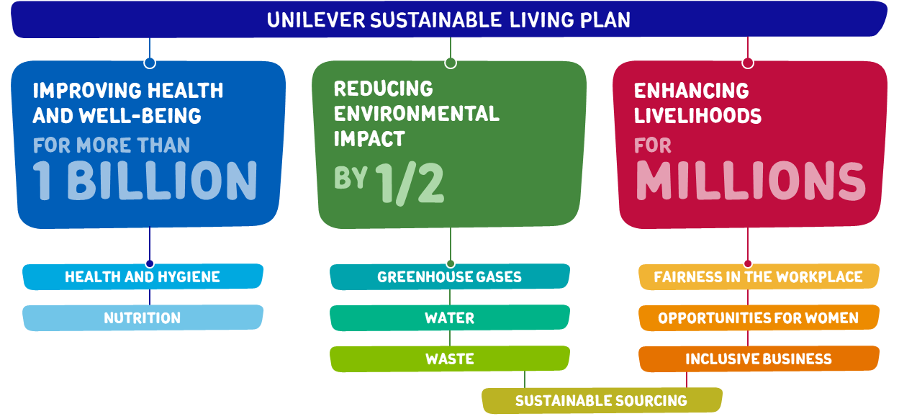

Unilever sustainable living plan

Slide 18
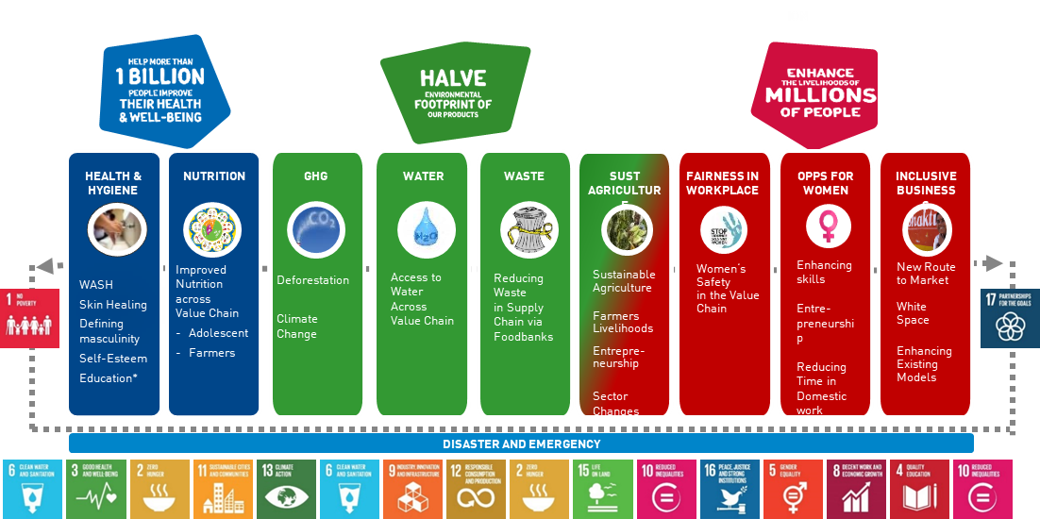
USLP and SDGs

Slide 19
USLP, SDGs and shared value
SDGs provide the agenda for the discussion between governments, businesses and NGOs for the next couple of years
USLP links to all SDGs except SDG 7 (Access to energy) and SDG 14 (Oceans).
  Direct link between SDG 2, End Hunger, which is also about sustainable agriculture, and Unilever Sustainable Sourcing Programme and RSPO
  Indirect link between e.g. SDG 11, Sustainable Cities and Communities, and Unilever Health and Nutrition pillars.
Shared value is generated though business strategies which lead to sound economic outcomes, but also protect and restore nature, and invest in and engage with local communities
RSPO P&C link to about half of the SDGs

Slide 21
Reaching the SDGs and generating shared value for people and nature with sustainable palm oil
Ahmadou Cisse
Cote D’Ivoire Smallholder Association

Slide 22
RSPO’s contribution to the SDGs

Slide 24
Alain Rival
Resident Regional Director for South East Asian Island Countries, Jakarta
CIRAD – The French Centre for International Cooperation in Agricultural Research for Development

Slide 25

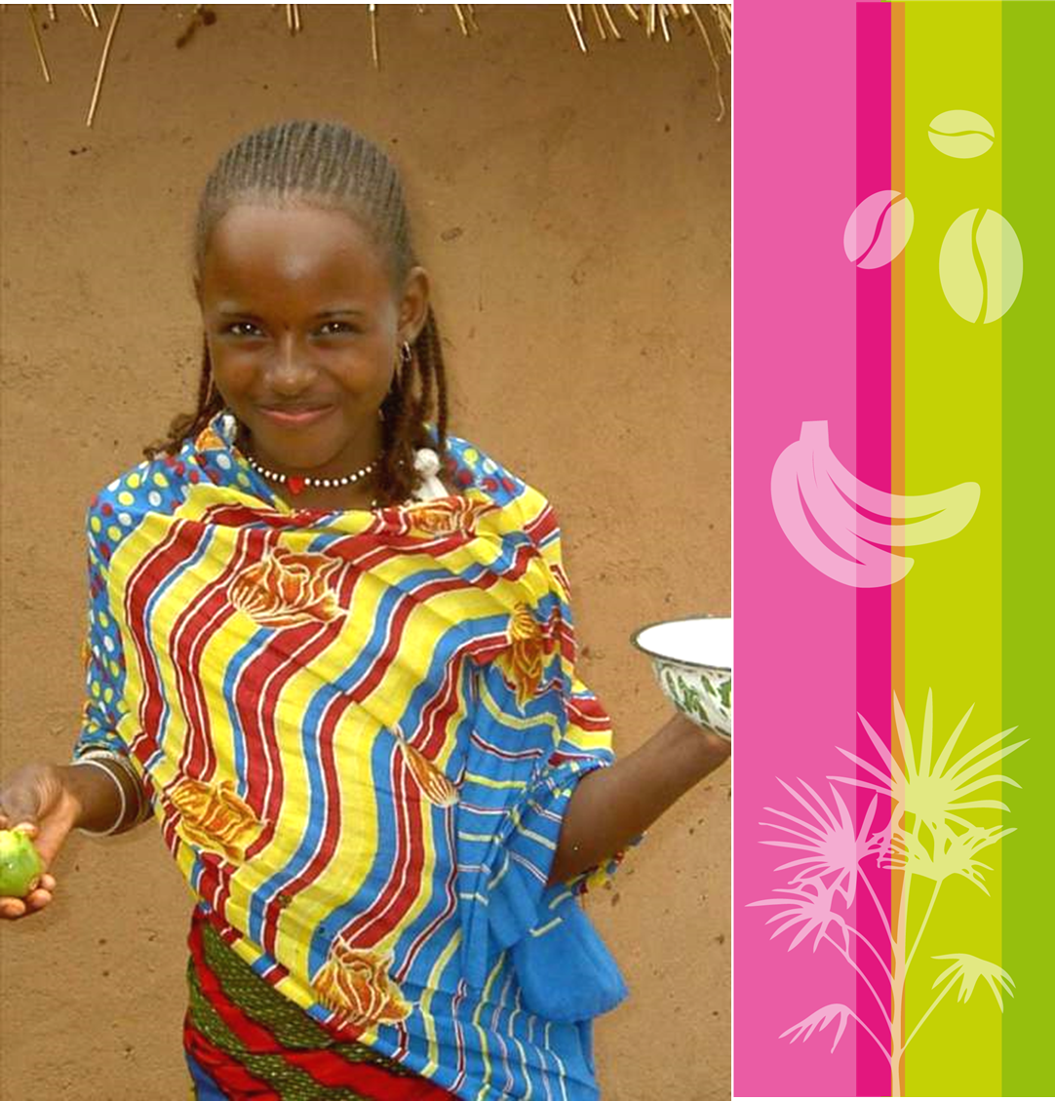
CIRAD: Who are we?
  CIRAD is a French research institution working with developing countries to tackle international agricultural and development issues.
  CIRAD has a global network of Research and Training Platforms in Partnership and regional offices, through which it develops R&D projects with more than 90 countries.
  A staff of 1,600, including 700 researchers.
  An annual budget of 220 million € - two thirds provided by the French government.
  A 70-years experience in R&D on the oil palm and its production systems.
      Agronomy
      Breeding
      Social Sciences
Working together for tomorrow’s agriculture

Slide 26
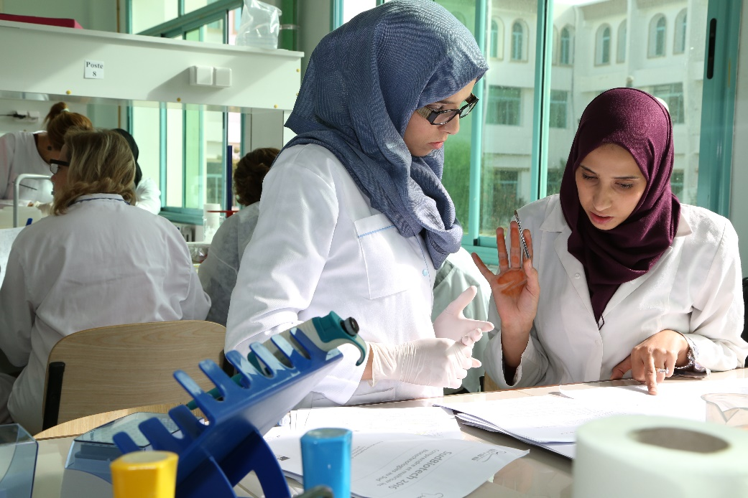
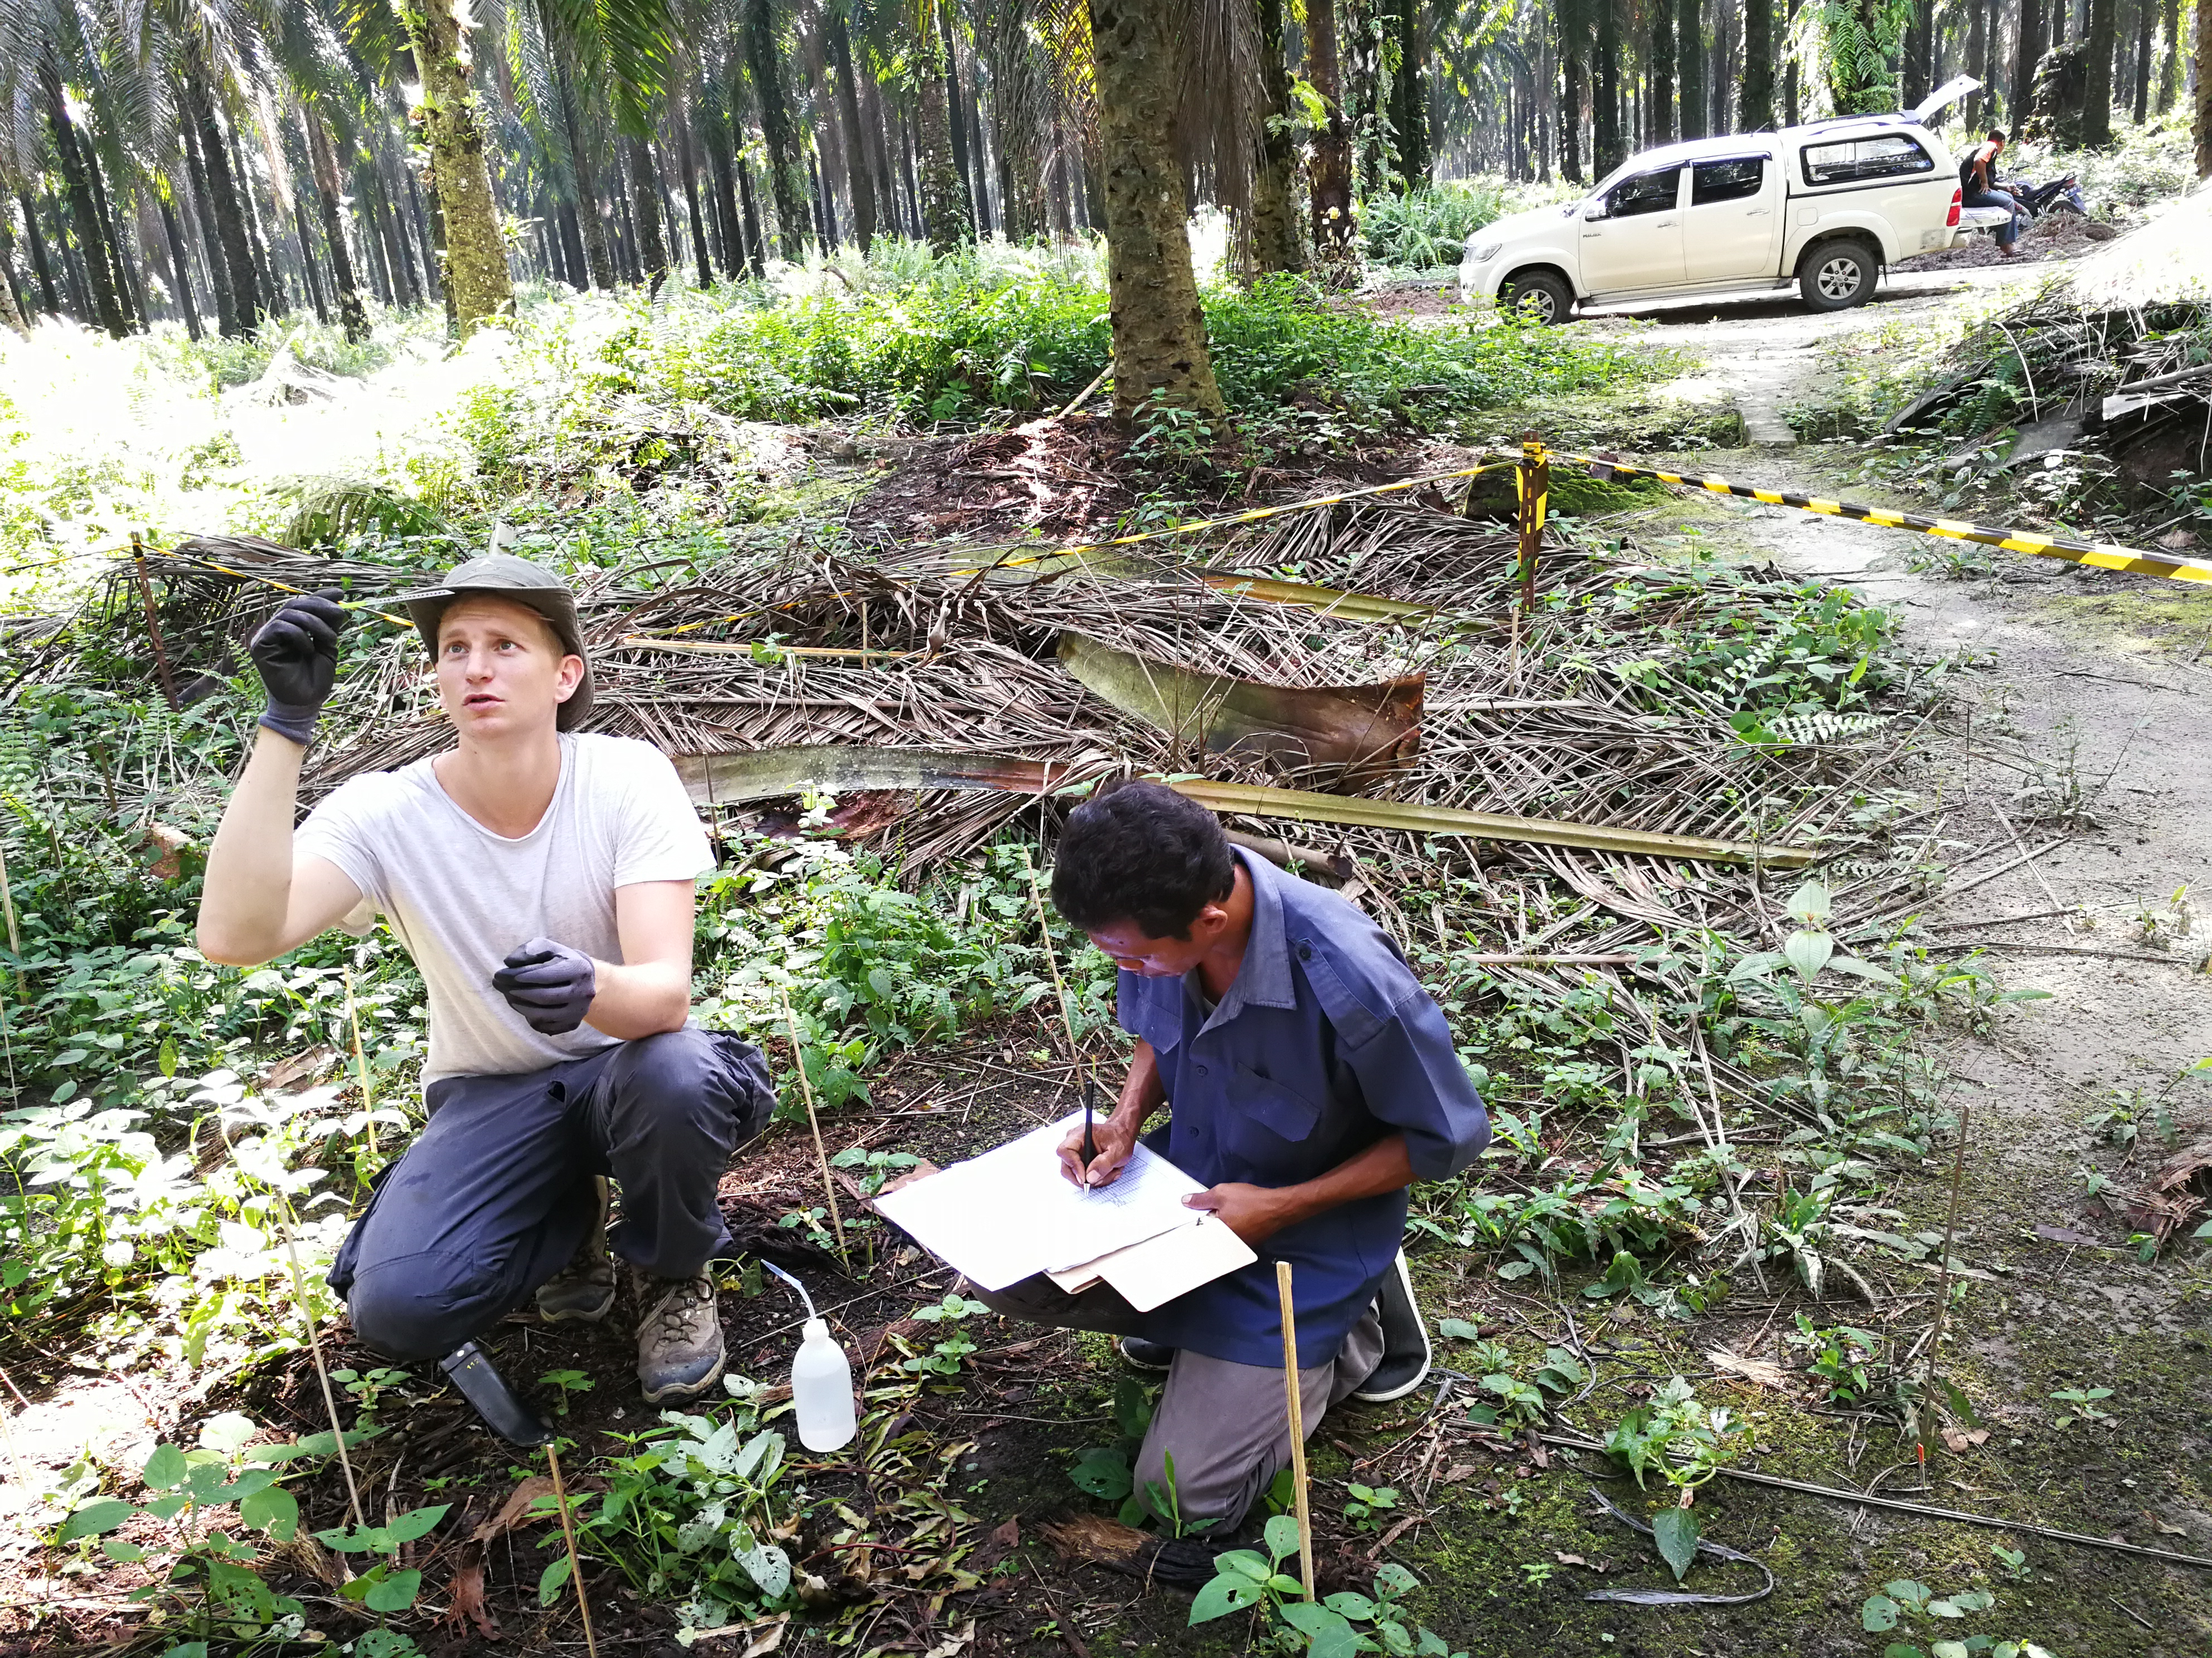
Shared value through science-based research, development and training
Certifying sustainability needs continuous R&D efforts
Filling knowledge gaps
  Long term collaborative research is needed
  Developing multidisciplinary approaches
  Providing science-base solutions to certification
Providing peer-reviewed, world-class research results
Disseminating and sharing science-based evidence and analyses as a common good
Training scientists, decision makers, extension officers
Bridging field research with questions emerging from the public and civil society:
  Drivers of deforestation
  Root causes of recurrent bushfires
  Transition towards Agroecology
  Understanding smallholders diversity and expectation

Slide 27
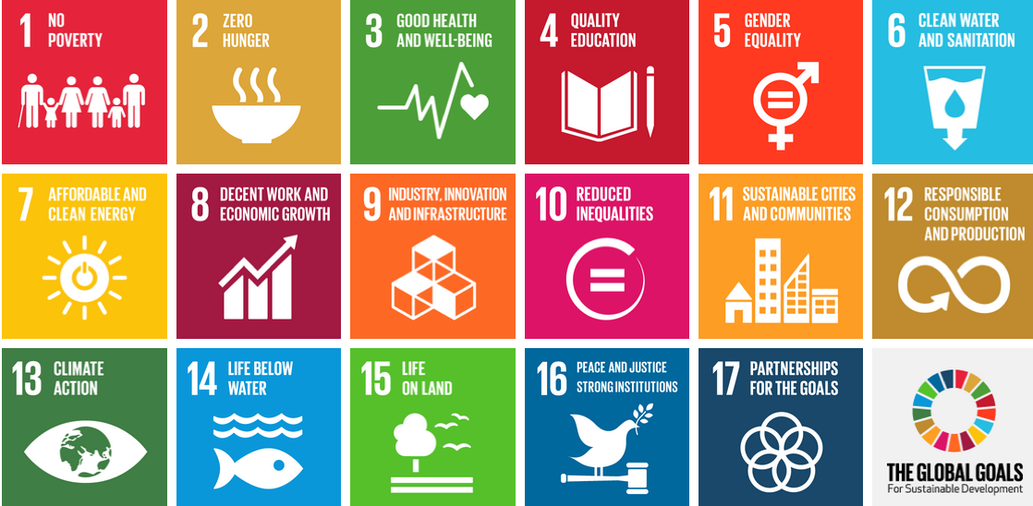
Acting through SDGs

Slide 28
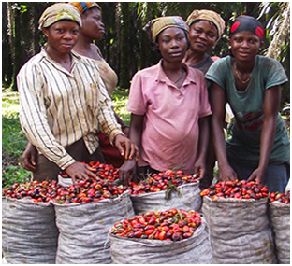
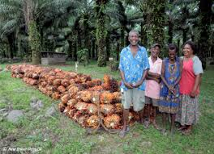
SDG 1: No poverty
Questions to agricultural research
  Conditions for poverty eradication through palm oil cultivation?
  Suitability of cultivation systems
  Lessons learned?
Partnership
  Smallholders Associations (SPKS Indonesia)
  Universities (UPM Malaysia)
  NGOs (WildAsia)
Achievements/outputs
  Describing and understanding smallholders diversity
  Time-based trajectories
  Drivers of changes in livelihood
  Adaptation of WAW approach (FAO)

Slide 29
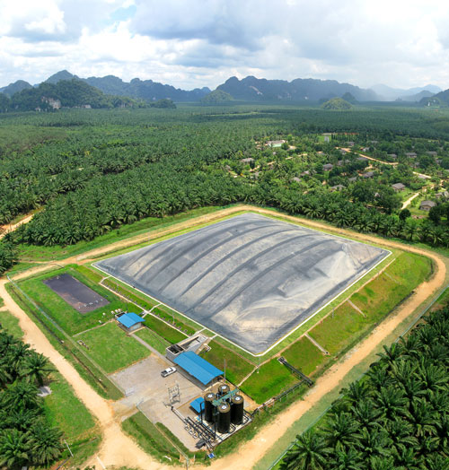
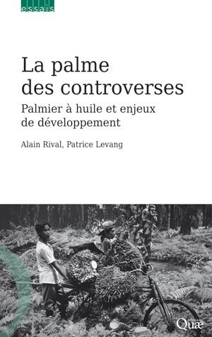
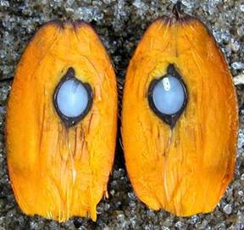
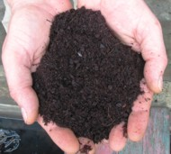
SDG 12 – Responsible consumption and production
Questions to agricultural research
  Continuous improvement of agricultural practices
  Generation and distribution of adapted planting material
  Information to the public
Partnership
  Research institutions
  Plantation companies
    PTSmart, Socfindo, Austindo, SIAT
Achievements/outputs
  Science-based approach of fertilisation
  Recurrent selection provides high yielding resistant palm varieties
  Environmental services : pollination, Integrated Pest management

Slide 30
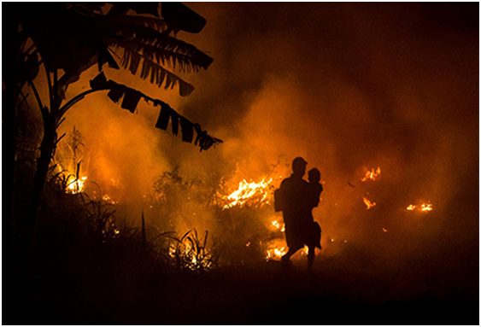

SDG 13 – Climate action
Questions to agricultural research
  How to anticipate and mitigate the effects of extreme climatic episodes?
  How to induce changes in agricultural prartices?
Partnership
  Research institutions
  Plantation companies
    PTSmart, Socfindo, Austindo, SIAT
Achievements/outputs
  Understanding the effects of El Nino episodes on the physiology of the oil palm
  Impact on productivity and time course of recovery
  Promoting changes in practices (bushfires)
  Generating adapted planting material

Slide 31
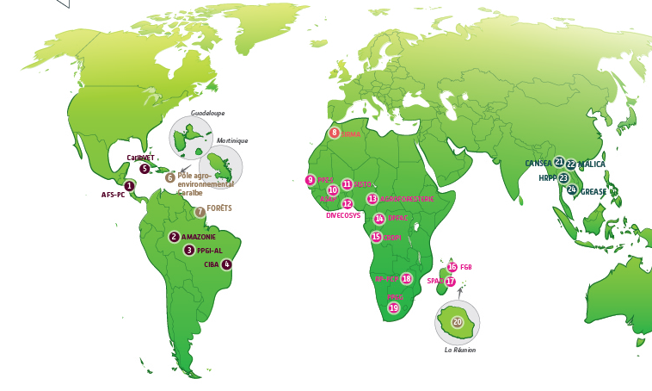
SDG 17 – Partnership for the goals
Collaborative research and training is in Cirad’s DNA : Mandate – Vision – Mission
Multidisciplinary research calls for the participation of a series of stakeholders:
  Universities – Research Institutions – Industry – NGOs – Governments (national and local)
Landscape planning and jurisdictional approach will involve new types of partnerships
Cirad manages 23 Research and Training Platforms in Partnership worldwide
Our project in SE Asia is to build up a new RTPP called SALSA:
  Sustainable Agricultural Landscapes in SouthEast Asia

Slide 32
THANk you FOR YOUR KIND ATTENTION
alain.rival@cirad.fr

Slide 33








Reaching the SDG’s and generating shared value for people and nature with sustainable palm oil
Moderated by: Eliza Anyangwe
Lim Sian Choo - Bumitama Agri Ltd
Ludovic Mirao II - WWF Regional Office for Africa, Yaounde Hub
Jan-Kees Vis - Unilever
Ahmadou Cisse - Cote D’Ivoire Smallholder Association
Alain Rival - CIRAD
GOLD PARTNERS
SILVER PARTNERS
RECEPTION PARTNER
EXHIBITOR

