Slide 2
WIFI and Twitter
Wifi
Username – RSPO
Password – EURT2018
Twitter
@RSPOtweets
#EURT2018

Slide 3
Afternoon breakout session
14:00 Landscape Approaches: Strengthening Partnership And Collaboration To Mitigate Risk And Ensure Long-Term Sustainability
Moderated by: Joost Gorter, New Foresight
Fitrian Ardiansyah - Country Director, Indonesia, IDH
Maria Amparo Alban - ACD Consulting
17:00 End

Slide 4
Breakout: Landscape Approaches: Strengthening Partnership And Collaboration To Mitigate Risk And Ensure Long-term Sustainability

Slide 5


Landscape approach and sustainable palm oil
inisiatif dagang hijau
Lessons-learnt of IDH-Sustainable Trade Initiative and partners
Fitrian Ardiansyah
Chairman of Executive Board IDH Indonesia

Slide 6














































IDH Indonesia & key partners
CEO/Chairman:
Fitrian Ardiansyah
DONORS
COFFEE
COCOA
Other Commodities:
Program Officer:
Melati (Coffee & Cocoa)
Kahfiya Hasbi (Aquaculture)
PLATFORMS
PALM
OIL
PULP & PAPER
TIMBER
Commodities & Landscapes:
Program Director:
Zakki Hakim
Program Managers:
Mila Nuh (SPM-Landscape)
Aris Wanjaya (PM-Landscape)
Program Officer:
Nadia Ridwan (Finance Officer Program)
Landscape Managers:
Riswan (Aceh)
Lorens (West Kalimantan)
Khusnul Zaini (Jambi)
Ifran (South Sumatra
AQUACULTURE
SPICES
GOVERNMENTS
Operations:
Andri Oarto (Ops Director)
Yashinta Wardhani (Finance Officer)
Yuli Setyawati (PA for Chairman)
PRIVATE SECTORS
Business Development & Innovative Finance:
Zakki Hakim
Communication Manager:
Manager:
Komang Arianti
CSOs

Slide 7














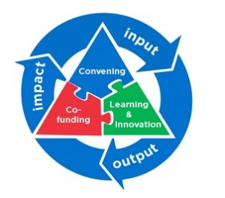





Approaches and impacts
Why?
We believe sustainable production and trade can transform markets for the benefit of people and the planet.
How?
IMPACT THEMES
CONVENING
CO-FUNDING
Smallholder
Deforestation
Living Wages
Agrochemicals
Gender
Input materials, GAPs, systems
1
Aggregators
2
Off-takers
5
INNOVATIVE
FINANCING
3
LEARNING
Farmers
4
Financiers

Slide 8


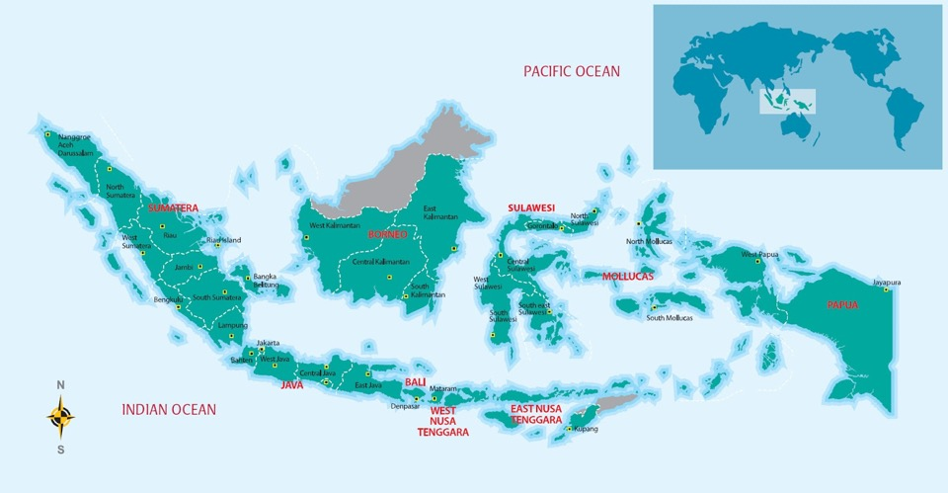






Our interventions in sustainable commodities
Cocoa
13. Sulawesi;
Leading & supporting CSP (Cocoa Sustainability Partnership)
Aquaculture
1. Aceh; 3. W. Kalimantan;
10,000 farmers, innovative finance
Coffee
2. S. Sumatra/ Jambi; 8. Lampung; 9. W. Java; 10. E. Java; ±54,000 ha; 831 kg/ha (>741 natl avg); National curriculum, GAP, innovative finance, trade links
Timber, Pulp & Paper:
2. S. Sumatra/ Jambi; 3, 11, 12. W., C. & E. Kalimantan;
2.1 mil ha (FSC certified); 1.66 mil ha (in process); Certification, productivity, protection
7
1
6
4
12
3
5
Landscapes
1. Aceh;
2. S. Sumatra/ Jambi;
3. W. Kalimantan;
Green Growth Plans,
30 companies, peat/forest mgt, KEE, PPI compacts, VSA
11
2
8
13
Palm Oil
2. S. Sumatra/ Jambi; 4. N. Sumatra; 5. Riau; 6. Sabah; 7. Europe (ESPO);
41,555 ha; 11,425 farmers; Mapping, traceability, legality, farmer organization, GAP, RSPO certification
9
10

Slide 9
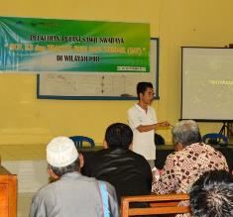














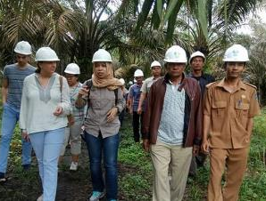
Sustainable palm oil – what we have learnt so far (i)
1
2
3
4
5
PARTNERS
10,000
207
6,288
60
3,000
SIZE (HA)
JAMBI
NORTH SUMATRA
SOUTH SUMATRA
RIAU
SABAH
5,000 independent
63
independent
4,500
ex-plasma
30
independent
1,500
independent & suppliers
FARMERS
Mapping & traceability (☑), legality & sustainable certification (ongoing)
Mapping, farmer organization & sust. certification (☑)
Organization strengthening, GAP, & sust. (>600 audited, >2000 certified)
Protocol development for peatland management
Field level traceability (☑), auto-GAP & mgt, innovative finance

Slide 10
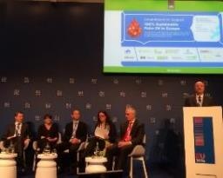








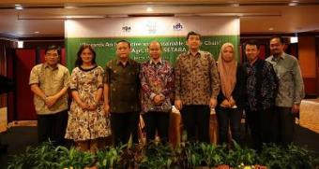

Sustainable palm oil – what we have learnt so far (ii)
6
7
8
9
PARTNERS
20,000
2,000
3
mills
Delivering sustainable palm oil at the source (e.g. a buyer from Norway decided to buy smallholder sustainability certificates from S. Sumatra – project #3), strengthening & delivering Amsterdam declaration (signed)
SIZE (HA)
SABAH
RIAU
SABAH & RIAU
688 independent
& suppliers
1,000 independent
N/A
none
FARMERS
GAP (↑14% productivity) & sust. certification (347 farmers, 2,100 ha certified)
GAP & sust. certification(mapping ☑, barriers in land legality)
Cost-effective methane capture w/ new tech, sust. certification (on-going)

Slide 11
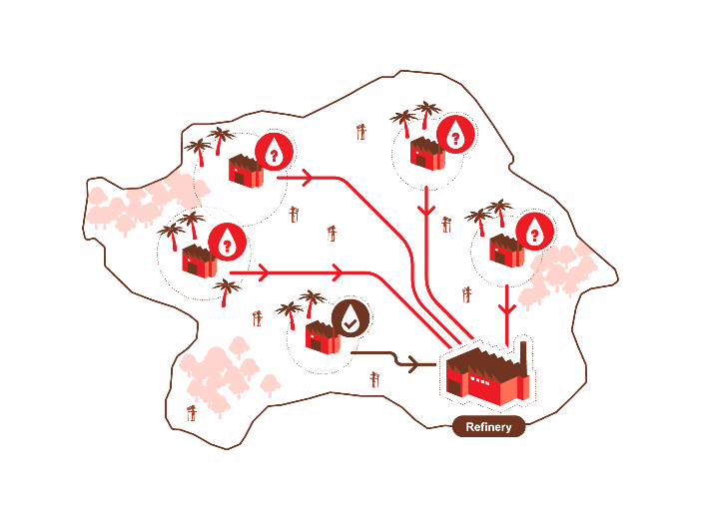






Landscape approach: beyond one supply chain
VERIFIED SOURCING
AREA (VSA)
PPI (PRODUCTION-PROTECTION-INCLUSION) COMPACTS
Government is key
SHARED ISSUES
WATER MANAGEMENT
PEAT/FOREST
FIRE
HCV (HIGH CONSERVATION VALUE) CONNECTION
SMALLHOLDERS
MAPPING, LAND LEGALITY & GAPs
ACCESS TO FINANCE
COLLA-BORATION
B/W MILLS
Images: Flaticon

Slide 12
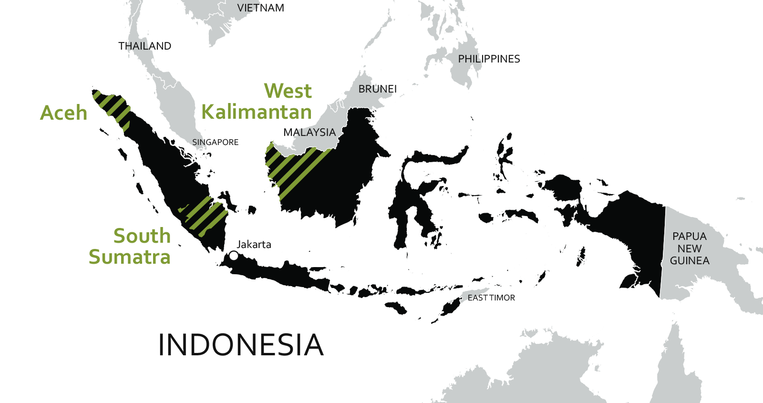
Our coverage in Indonesia
Key interventions: Green Growth Plans, PPI (production-protection-inclusion) compacts with 30 companies, peat/forest management, KEE (Essential Ecosystem Area), VSA (Verified Sourcing Area)
West Papua & Papua
& Jambi
€2.6M (IDH) €2.6M (PRIVATE SECTOR & OTHERS) investment

Slide 13
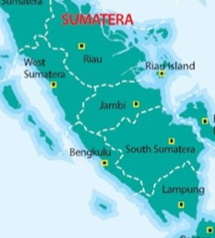
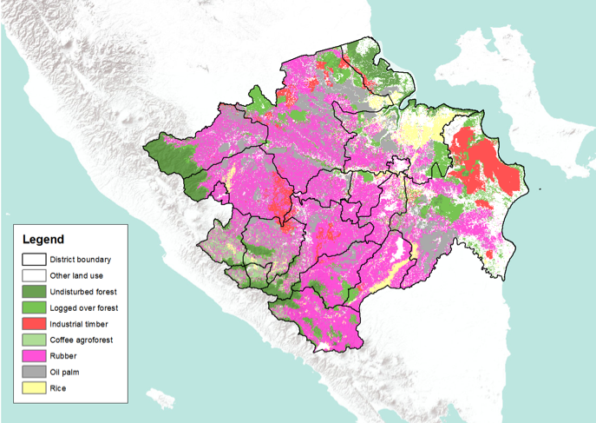
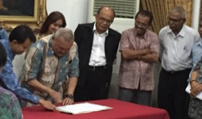
Example (i): South Sumatra
GREEN GROWTH PLAN OF SOUTH SUMATRA
Increased productivity of rice and oil palm; Good agricultural practice, Rubber auction market, Mini CPO mill
Increased productivity rubber; Good agricultural practice, Rubber auction market; Better connectivity
Avoiding deforestation and natural forest degradation; Peat land restoration
JAMBI
SOUTH
SUMATRA
Avoiding deforestation and degradation; Forest restoration, ecosystem service for water
DANGKU-SEMBILANG NP
LAND USE PLANNING & ALLOCATIONS THAT ARE COMPLIANT, EFFECTIVE & FAIR
OKI
BUKIT BARISAN SELATAN NP
INCREASED ACCESSES TO FIVE CAPITALS
IMPROVED PRODUCTIVITY & BENEFIT FROM A UNIT AREA
IMPROVED VALUE CHAIN W/ BETTER BENEFIT SHARING
Increased productivity of coffee, rubber and oil palm ; Good agricultural practice, Ecosystem service for water provision
Avoiding deforestation and natural forest degradation; Forest restoration
INCREASED CONNECTIVITY & ECONOMY OF SCALE
powered by
EFFECTIVE FOREST & LANDSCAPE RESTORATION
LUMENS
EFFECTIVE INCENTIVE MECHANISM OF ECOSYSTEM SERVICES

Slide 14
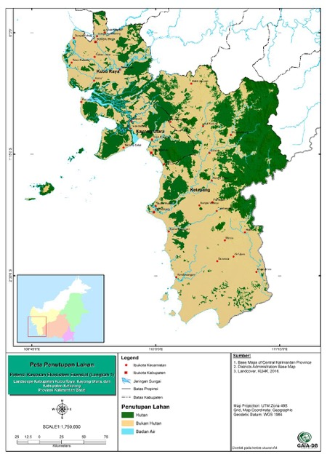












Example (ii): West Kalimantan
FOREST
1
PARTNERS
COMMODITIES & TRADE LINKS
TIMBER
PALM OIL
PULP
COCONUT
RUBBER
SHARED INTERVENTIONS
Green Growth Plan finalized
KEE (Essential Ecosystem Areas) recognizing 0.5 mil ha of HCV
FOREST & PEAT
5 concession agree for a shared peat water mgt
Fire-free villages
WATER MANAGEMENT
FIRES
Land legality, SH productivity, 82,000 ha of village forest
ORANGUTAN
SMALLHOLDERS

Slide 15
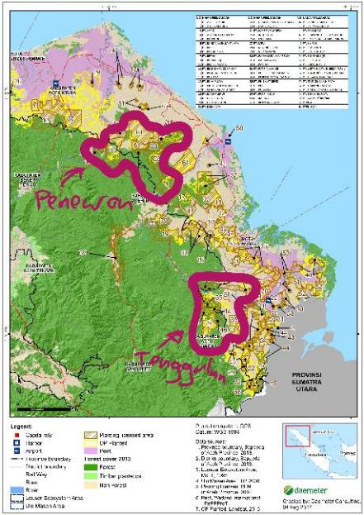
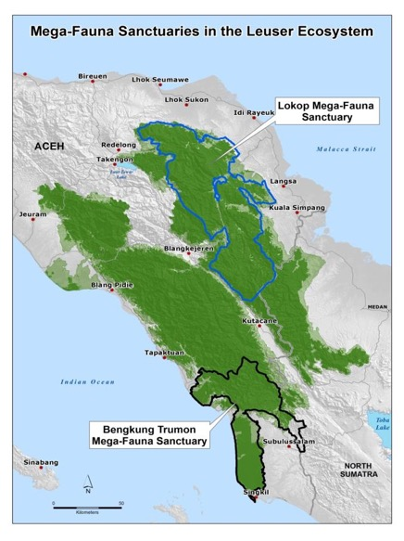





Example (iii): Aceh
PRODUCTION
PROTECTION
INCLUSION
PARTNERS
24,668 HA
(ESTIMATED)
9,000 HA
(3,000 HA ON PLANTATION
+ 30 KM LONG TRENCH BUFFER ZONE)
OTHER COMMO-DITIES
PT TUALANG RAYA, PTPN 1, DKS, BUMI FLORA, ATAKANA, FKL, MILL COMPANIES
PENEURON
(A. TIMUR)
COCOA
RUBBER

Slide 16

Example (iv): Jambi
SURROUNDING
BERBAK NP (LINK: SEMBILANG NP IN S. SUM; 3 EXISTING PROJECTS: PALM & FORESTRY)
KEY LANDSCAPE
BUKIT 30 NP
KERINCI NP
JAMBI
BERBAK NP
SOUTH SUMATRA
BUKIT 12 NP
SURROUNDING:
BUKIT 12 NP (LINK: PALM OIL & FOREST & POTENTIAL ANDGREEN.FUND)
BUKIT 30 NP (LINK: RUBBER, PULP, PALM, POTENTIAL ANDGREEN.FUND)
Source: WARSI
KERINCI NP (LINK: UNESCO WORLD HERITAGE & SPICES)

Slide 17
Innovative financing: scaling up investment
Total projected financing need for complete rehabilitation & replanting key commodities ± US$ 4billion (&GreenFund ≈ US$125 million)
Risk-layering critical to attract long-term private capital needed
Strong protection components
KEY FOR SCALE: supply chain companies, government of Indonesia and donors must de-risk 3rd party financing
ANDGREEN.FUND
1
Agro//forestry products

Slide 18
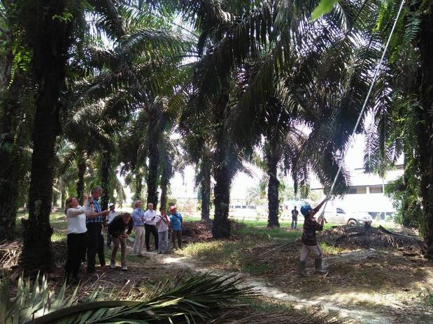
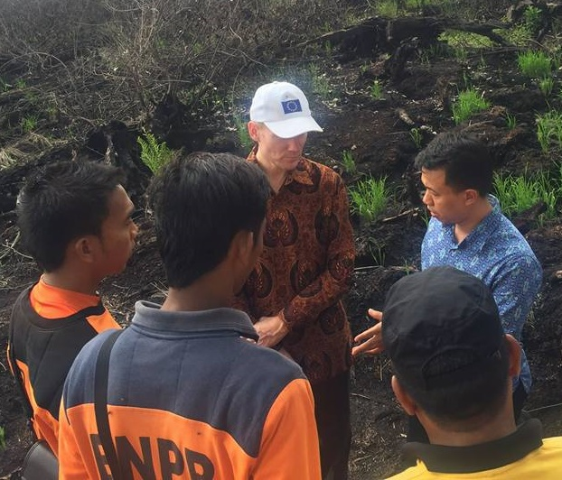
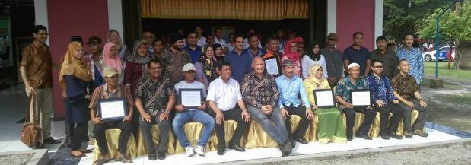
Thank you
Ardiansyah@idhtrade.org
http://www.idhtrade.org/

Slide 20
JURISDICTIONAL APPROACH: AN OPPORTUNITY FOR LANDSCAPING: LESSONS LEARNED FROM THE ECUADORIAN EXPERIENCE
Maria Amparo Alban
ACD Consulting

Slide 21
What is JA exactly?
Is currently a “learning by doing process”
  It is not a goal BY ITSELF, it is a process ( LIvE ORGANISM)
  in the case of ecuador it departed from a redd+ jurisdictional Approach
  (Reducing Emissions from Deforestation and forest Degradation)
No recipe, only some criteria and lessons learned
Poses more questions than answers
          But opens up many opportunities for landscaping and conservation, but specially strengthening environmental and social governance in a territory

Slide 22
What kind of institutional governance should SUPPORT it?
How big THE AREA should be?
Who benefits from it, exactly?
Who should champion for it?
Are there any prerequisites?
What are the gains for palm oil growers?
Could I still expand ?
Others…
Common questions raised about JA

Slide 23
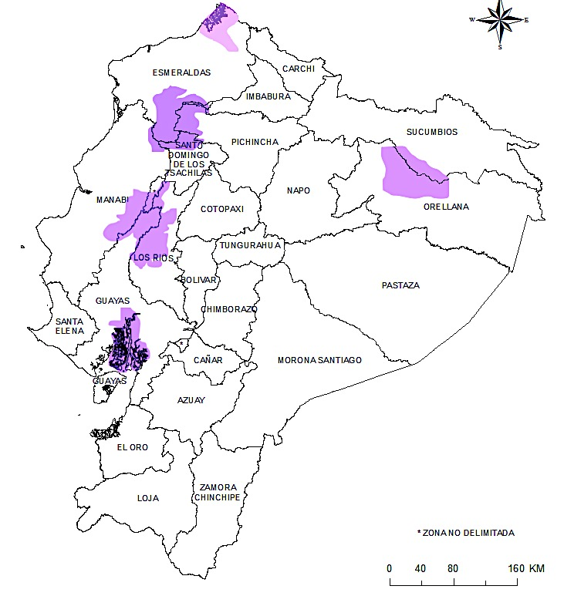
Some criteria so far…
  It´s intended to scale up and to leverage the capacity of oil palm small farmers to access certification schemes like RSPO or incorporate new standards in territories with difficulties accessing certification individually.
It´s directed at a plurality and diversity of stakeholders.
There should be prior assessment of conditions (institutional, political, social, economic, environmental)
Should be relatively easy to determine
a geographical district.
“What is the driver for the agreement”

Slide 24
Some conditions should exist, or be facilitated
Willingness to craft an agreement that:
  Boost production yield and better small farmers conditions
  Reaches commitment for less or no deforestation
  Create a multi-sectorial dialogue to address all the issues
  Involve authorities (agricultural and environmental agencies at least)
  Involve civil society and academia
  Involve municipalities or local authorities (land use planning)

Slide 25
Challenges for landscaping
Sometimes, oil palm is not the only crop or driver for deforestation within a territory. (there can be “mosaic crops”) If a certification for all is not possible, oil palm should be identified with it´s own certification.
Local authorities often do not recognize/acknowledge it´s roll in land use planning to avoid deforestation, there is a space for national or regional policy as part of their development plans.
There is a cost built in the different studies and activities ( who/whom should bear the cost $, there should be a financing strategy)
It should rely on deforestation commitments as well as on a raise of productivity that should incorporate other incentives.
Social, institutional, economic and environmental conditions should be properly assessed prior to launching the process. Buy in and consensus should be carefully crafted to secure an agreement for the long run.

Slide 26
Opportunities arise
Creates a new “governance model”, some sort of “steering committee” is needed with multi-stakeholder participation, with monitoring capacities
Once the agreement is on, it facilitates governance, determining roles for each stakeholder
Aimed at boosting productivity and yield for small producers, could be used along with developmental plans from governments. technical cooperation fits in
Secures market access in the long run
Facilitates relations with civil society and creates capacity among member of the initiative
There is important space to shape and adapt this mechanism to conditions in every territory

Slide 27
THANK YOU FOR YOUR ATTENTION!

Slide 28








Breakout: landscape approaches: strengthening partnership and collaboration to mitigate risk and ensure long-term sustainability
Moderated by: Joost Gorter, New Foresight
Fitrian Ardiansyah - Country Director, Indonesia, IDH
Maria Amparo Alban - ACD Consulting
GOLD PARTNERS
SILVER PARTNERS
RECEPTION PARTNER
EXHIBITOR

