Slide 2
WIFI and Twitter
Wifi
Username – RSPO
Password – EURT2018
Twitter
@RSPOtweets
#EURT2018

Slide 3
Afternoon breakout session
14:00 Everything You Didn’t Know About Oil Palm And Biodiversity
Moderated by: Laure d’Astorg - Alliance for the Preservation of Forests
Marc Ancrenaz - Borneo Futures - HUTAN - IUCN Oil Palm Task Force
Prof Erik Meijaard - Chair, IUCN Oil Palm Task Force
15:15 End

Slide 4
Breakout: Everything You Didn’t Know About Oil Palm And Biodiversity

Slide 5
Everything you didn’t know about oil palm and biodiversity
Marc Ancrenaz
Borneo Futures – HUTAN – IUCN Oil Palm Task Force

Slide 6
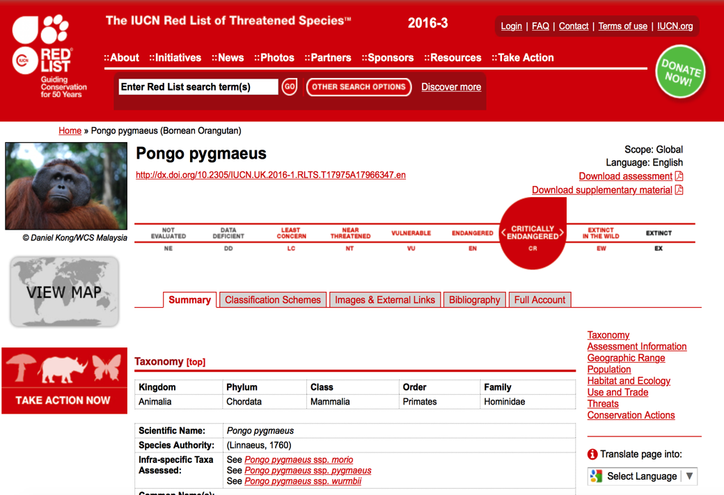
Orang-utan: critically endangered

Slide 7
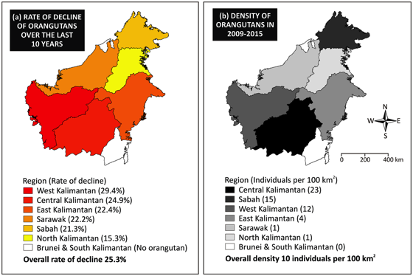
Rationale
Rapid decline:
1950-2010: > 60%
2010-2025: further 22%
Reasons:
Habitat loss
Hunting
Santika, T., Ancrenaz, M., Wilson, K.A., Spehar, S., Abram, N., …., Meijaard, E. 2017. First integrative trend analysis for a great ape species in Borneo. Scientific Reports, 7: 4839. DOI: 10.1038/s41598-017-04435-9.

Slide 8
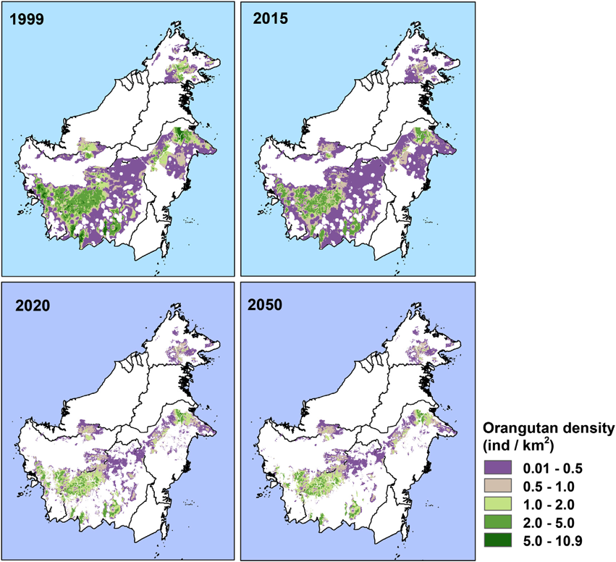
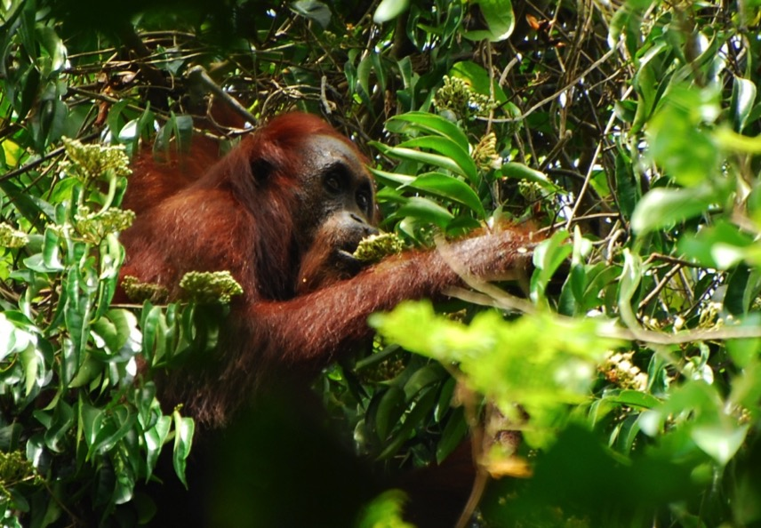
Rationale
Loss of 100,000 individuals in 15 years
Voigt, M., Wich, S.A., Ancrenaz, M., Meijaard, E., …, Kuhl, H. 2018. Global demand for natural resources eliminated more than 100,000 Bornean orangutans. Current Biology 28: 1-9. https://doi.org/10.1016/j.cub.2018.01.053

Slide 9
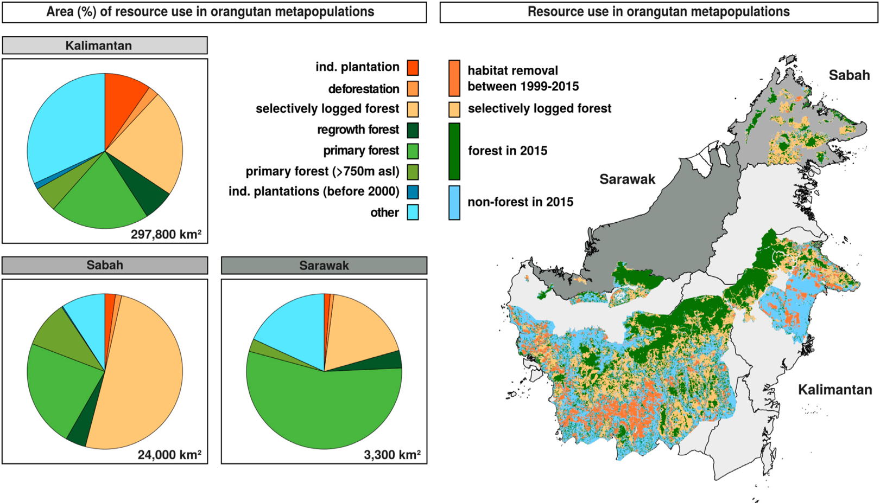
Situation, today

Slide 10
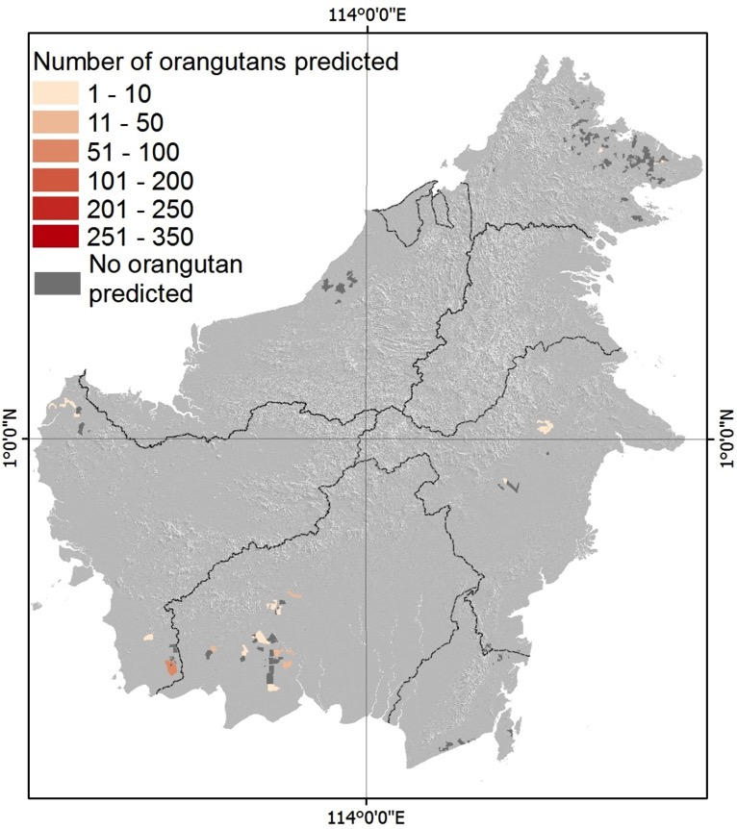
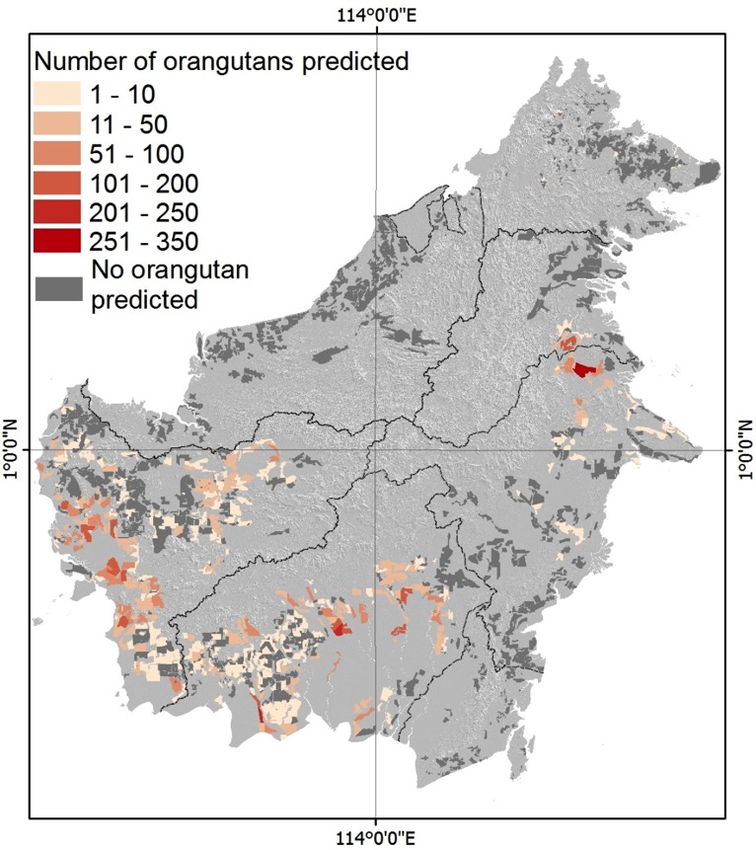
10,000 Orangutans in non certified oil palm plantations

Slide 11
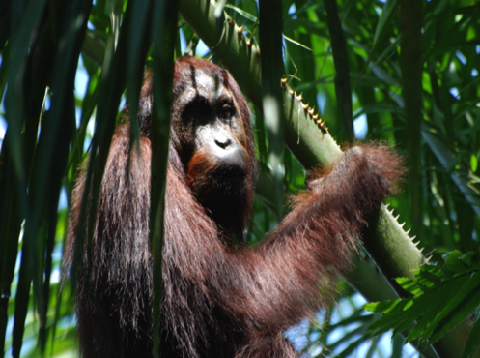
Orangutans in agricultural landscapes
Highly adaptive species
Need for suficient food resources
Need for sufficient resident females
Very slow reproduction cycle
Susceptible to fragmentation
Susceptible to hunting
Susceptible to health issues (?)
Large home range

Slide 12
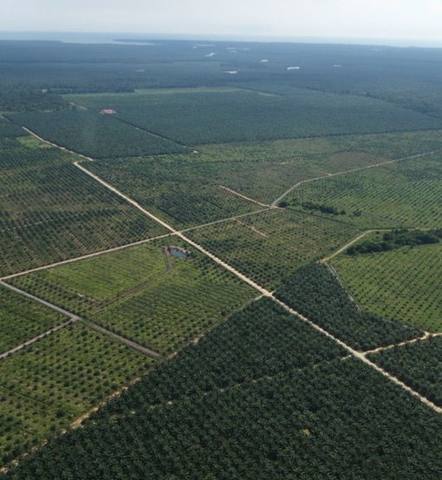
Need for large scale management
Protecting forests with significant populations
Designing strategies at meta-population level
Identifying large scale connectivity: ability to move from one place to another
Respect of large scale level dynamics (ecosystem services)
Better management of set asides
Enhancing forest regeneration
Improving species protection

Slide 13
Jurisdictional or landsape approach?
Jurisditional = Sub-national programme to realize sustainability goals across an administrative region
Landscape = inter-connected social, environmental, economic and political challenges at landscape scale through integrated solutions
Framework to articulate:
Sustainability initiatives across sectors
Mitigation strategies for climate change
Social objectives
Benefits:
Reduced costs of monitoring deforestation
Low-risk for long-term investment
Increased legal compliance
Conflict resolution between companies and communities

Slide 14
Jurisdictional approach – A possible solution to 100% CSPO regions
Introduced and launched at RT13 in 2015
Currently being attempted in Indonesia (Central Kalimantan and South Sumatra), Malaysia (Sabah) and the whole nation of Ecuador
Each region is “doing it their own way”, however they still needs to adhere to RSPO’s Principles & Criteria's to achieve Certification
Strengths:
It’s new
It is primarily a Top Down approach with involvement of Government, which means immediate buy in when done using laws/policies by producers
It’s an incredible opportunity to eliminate labours abuses and improve landscape level planning to the benefit of conservation
All regions are expecting that it will be easier to sell with ease of mind of the buyer
Weakness:
It’s new
With a change of Government what would happen?
A crucial lack of expertise, everyone is on a learning curve
There is confusion of how the standard will actually work and to address this the Jurisdictional Approach Working Group (JAWG) was established and has had its first meeting in May 2018, we should have started with having the JAWG first, as much time and money has been wasted
RT16 will be in Sabah, Malaysia and provides an ample opportunity to examine the Jurisdictional Approach in Sabah as a “petri dish” example.

Slide 15
Breakout: Everything You Didn’t Know About Oil Palm And Biodiversity

Slide 16
Everything you didn’t know about oil palm and biodiversity
Erik Meijaard
Chair, IUCN Oil Palm Task Force

Slide 17
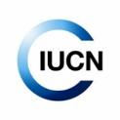
The IUCN oil palm task force
The International Union for Conservation of Nature (IUCN): Membership Union composed of government and civil society organisations;
Goal: To provide the knowledge and tools that enable human progress, economic development and nature conservation to take place together;
World’s largest and most diverse environmental network;
1,300 Member organisations and some 10,000 experts.
IUCN Resolution 061 – IUCN Congress 2016
CALLS ON the Director General and the Commissions to establish an Oil Palm and Biodiversity Task Force
REQUESTS to conduct a situation analysis on the implications for biodiversity conservation from the expansion of oil palm, and to review and define best practices in the industry
IUCN Oil Palm Task Force established in 2017 (runs until 2020)

Slide 18
Situation analysis
Published today (translated into French)
Objective, neutral, scientific voice in a highly polarized debate
Three sections
Past – Impacts of Palm Oil
Present – Governance and management
Future – Scenarios
Knowledge gaps

Slide 19
Finding 1. Palm oil is here to stay

Slide 20
Finding 2: Environmental impacts palm oil are large, but localized

Slide 21
Palm oil and deforestation
New maps global distribution industrial-scale oil palm: 18.7 million ha
Smallholder oil palm difficult to map. Some 40-50% of area = smallholder (18.7 mha + 40/50% = 26 – 28 mha globally; slightly larger than all of the UK
Comparison: maize 187 mha; soy 121 mha; rapeseed 33 mha; peanut 28 mha; sunflower 26 mha; coconut 12 mha; olive 11 mha
Globally palm oil not a major contributor to deforestation. <0.5% of all deforestation caused by palm oil
Locally, palm oil the main cause of deforestation. Parts of tropics up to 50% of deforestation caused by palm oil
When oil palm replaces rainforest, biodiversity and environmental impacts are large

Slide 22
Finding 3: Impacts extend beyond biodiversity losses

Slide 23
Finding 4: Most palm oil not certified – poorly controlled production

Slide 24
Finding 5: No easy was forward. We are at war, but collaboration is needed

Slide 25
Finding 6: Everyone has a role to play

Slide 26
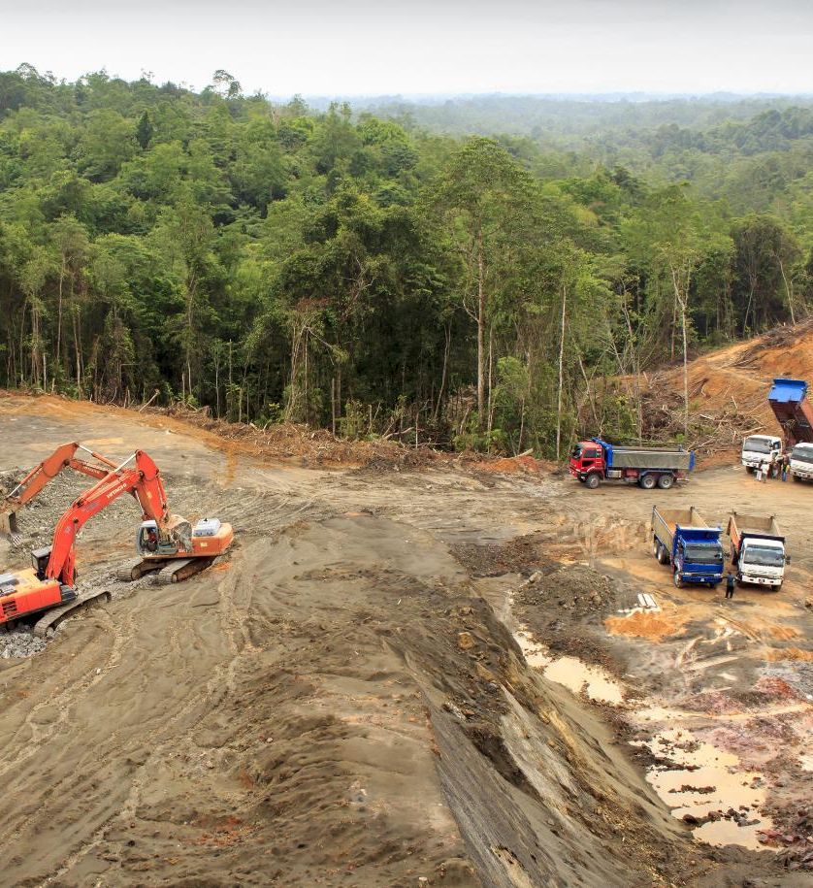
What we know
Palm oil is everywhere and important for food security and development.
Palm oil production increased 15-fold between 1980 and 2014 and will increase further.
Oil palm expansion could affect 54% of threatened mammals and 64% of threatened birds globally.
Other oils have lower yields than oil palm. Replacing palm oil with other oils displaces and displaces the problem.
Avoid deforestation

Slide 27
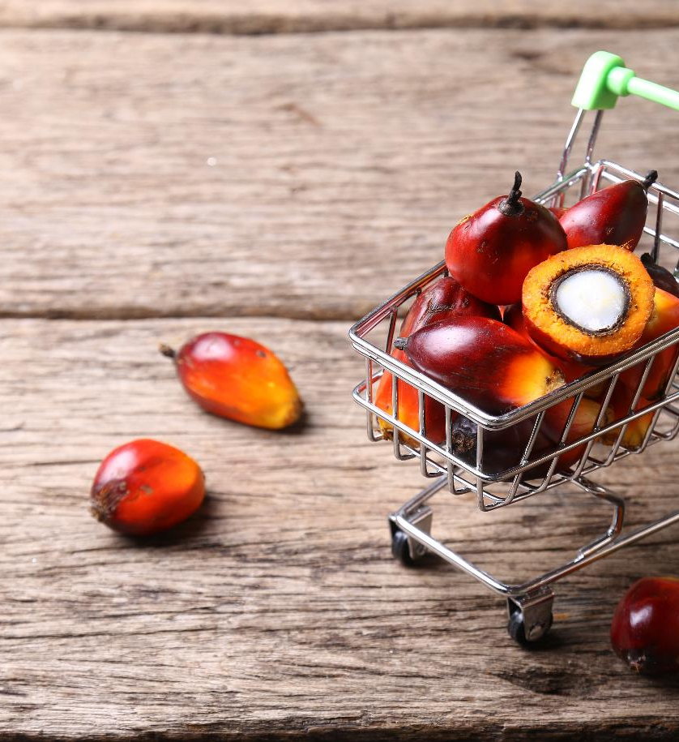
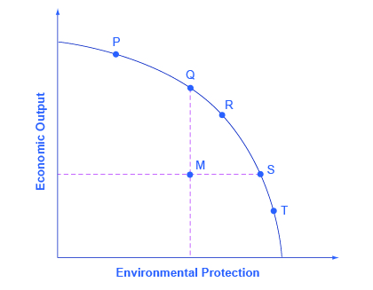
What we don’t know
What does sustainability actually mean?
Sustainable Development Goals
ending poverty and hunger;
ensure sustainable energy;
promote economic growth;
halt biodiversity loss
Etc

Slide 28
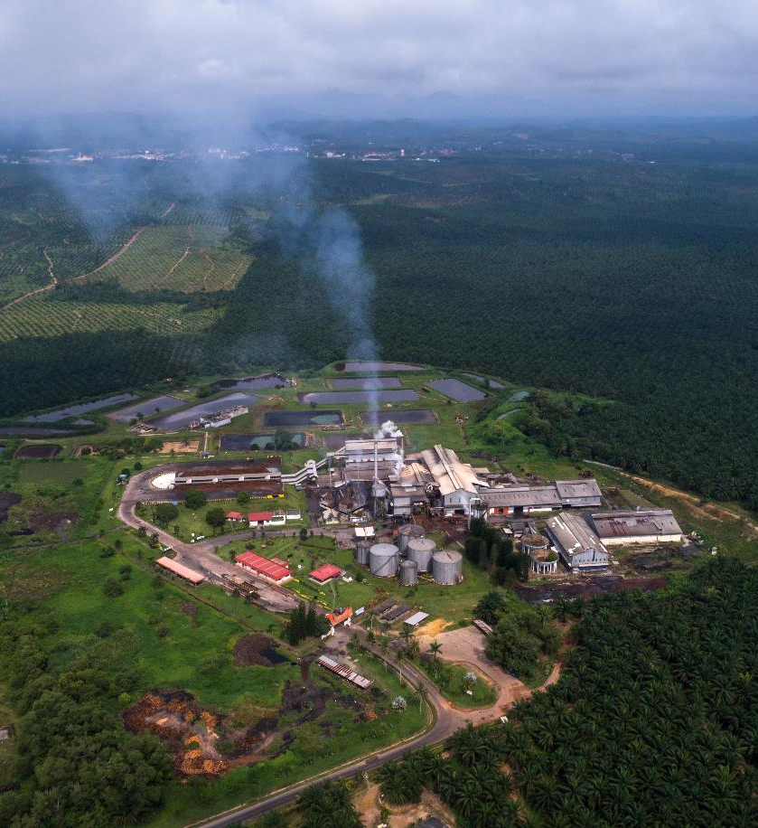
What we think we know, but don’t know
The global trade-off question: How does reduced demand for palm oil affect global deforestation, environmental impacts, and economic development from overall production of vegetable oils?
Banning palm oil is good for tropical forest and orangutans. Is it?

Slide 29
Next steps
Study the socio-economic dimensions of palm oil
Preliminary result in Indonesian Borneo show that palm oil does not always alleviate poverty
Palm oil versus other oil producing crops
Work with the industry on better practices

Slide 30
Breakout: Everything you didn’t know about oil palm and biodiversity
Moderated by: Laure d’Astorg - Alliance for the Preservation of Forests
Dr Marc Ancrenaz - Borneo Futures - HUTAN - IUCN Oil Palm Task Force
Prof Erik Meijaard - Chair, IUCN Oil Palm Task Force
GOLD PARTNERS
SILVER PARTNERS
RECEPTION PARTNER
EXHIBITOR

